Slide 1
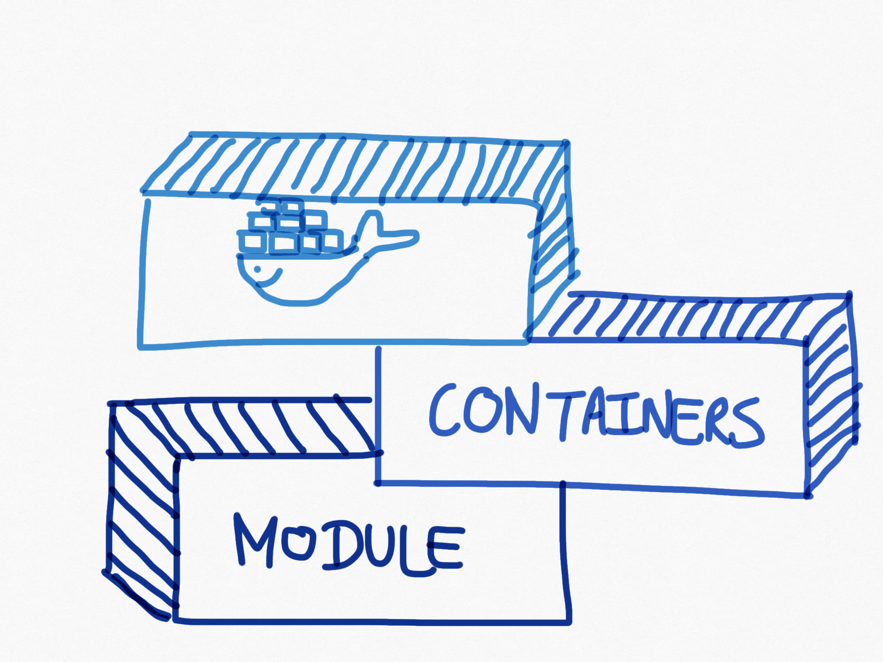

Slide 2
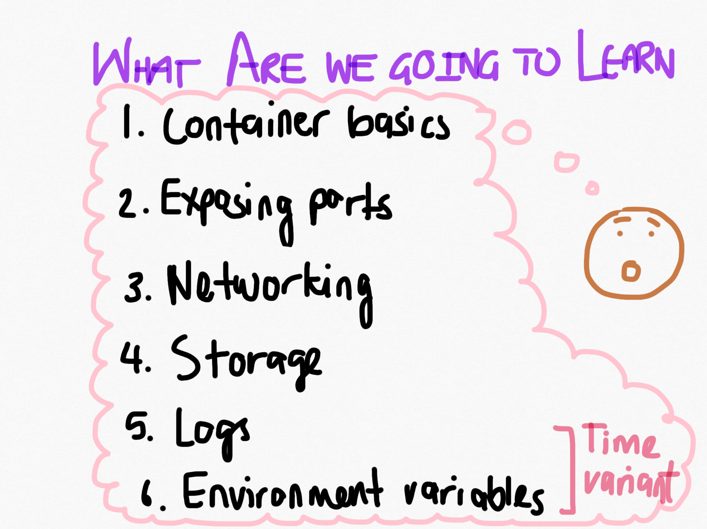

Slide 3
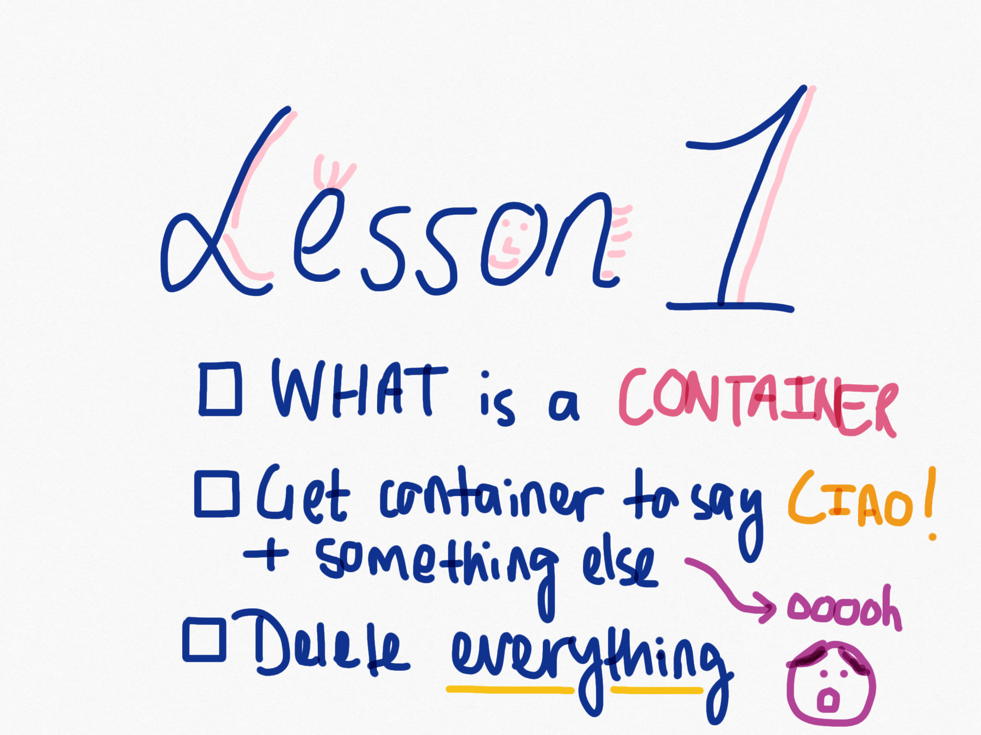

Slide 4
Defining a container
A container packages up all the code and dependencies needed for an app to run
Containers isolate software from environment
Solves the problem of getting software to run reliably in different environments
Images become containers at runtime
Containers use portions of the host OS’ resources
Stateless
There are ways to persist data in a container
Notes:
E.g. can run ruby2.5 and ruby2.0 on different containers on same host

Slide 5
Container pros
Containers enable isolation
Decouple applications from OS
Secure workspace
Containers enable portability
Can run on any machine, can deploy on any machine
What you build and run locally is same in production
Containers enable scaling
Lightweight and can be modified with ease
Their use
Most commonly at REA we use containers to run our app images and any dependencies

Slide 6
Extra reading
What is a container
Why containers?
Container vs VM

Slide 7
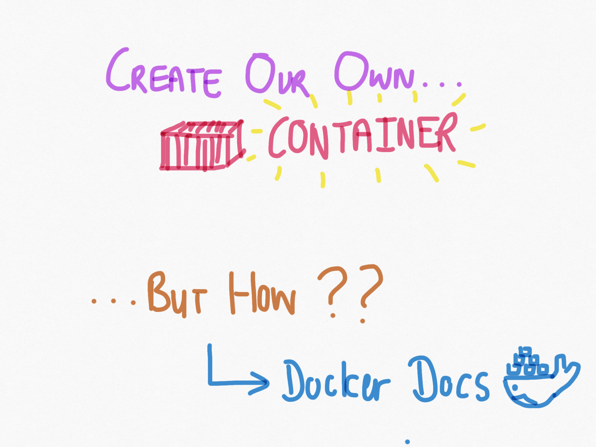

Slide 8
Best resource
https://docs.docker.com/engine/reference/commandline
Look at the side tab, it consists of all docker commands you could ever need.

Slide 10
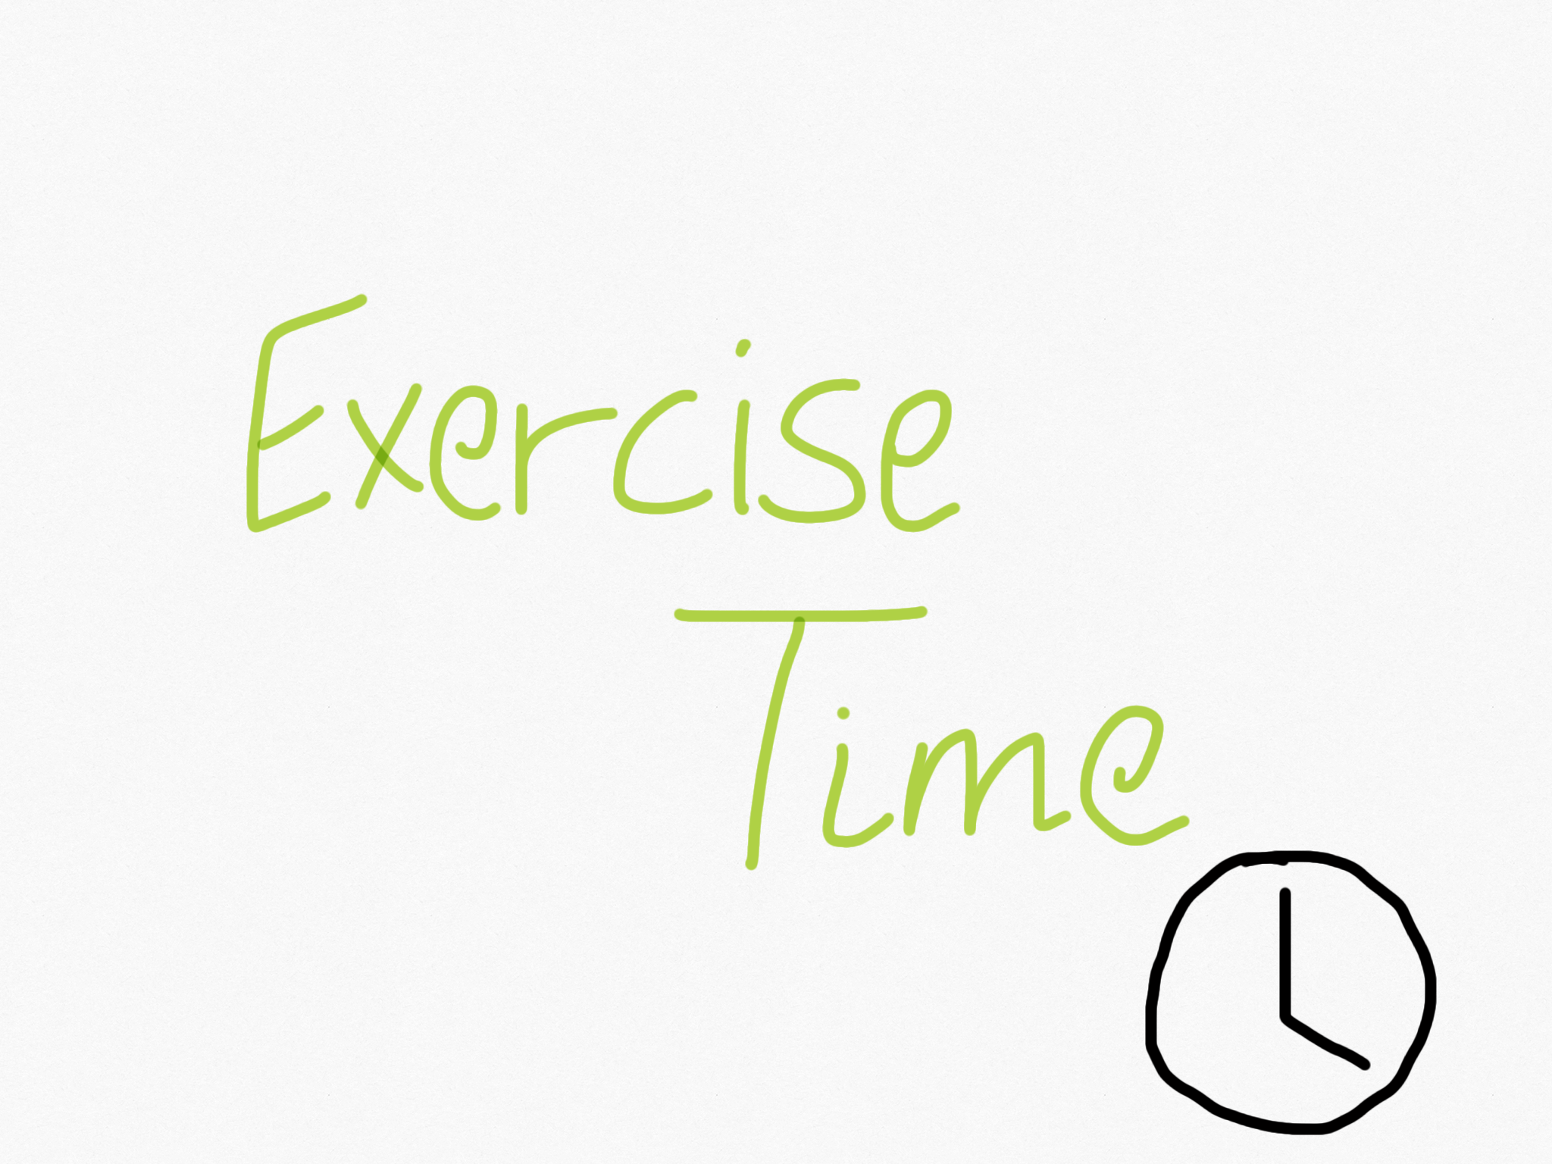

Slide 11
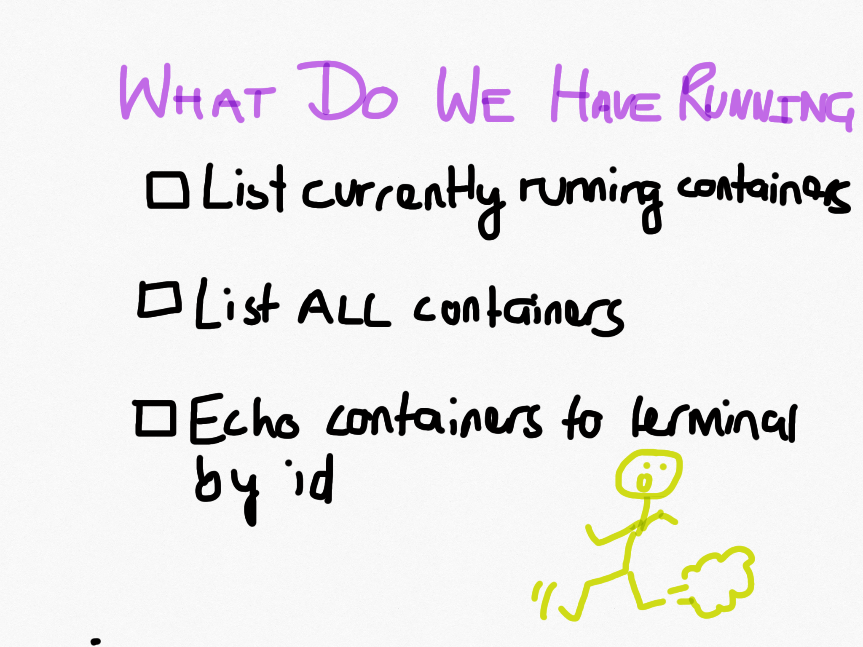

Slide 12
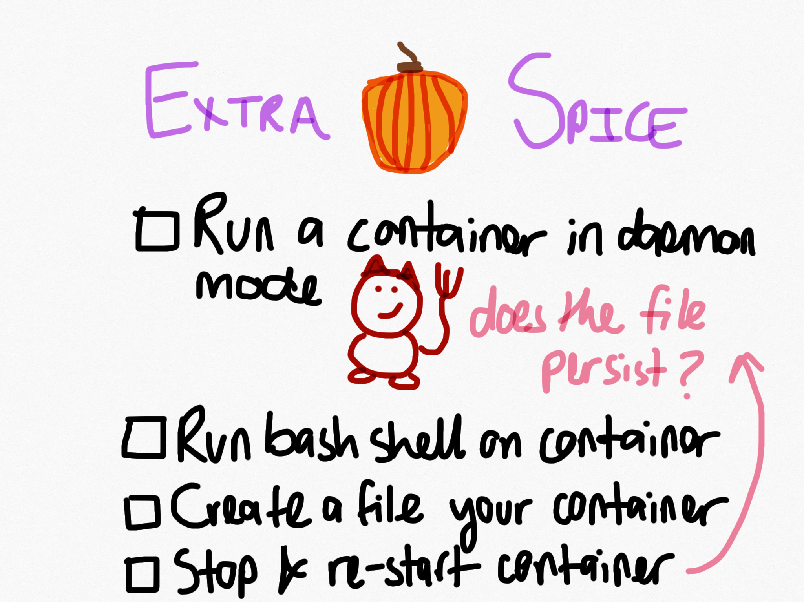

Slide 13
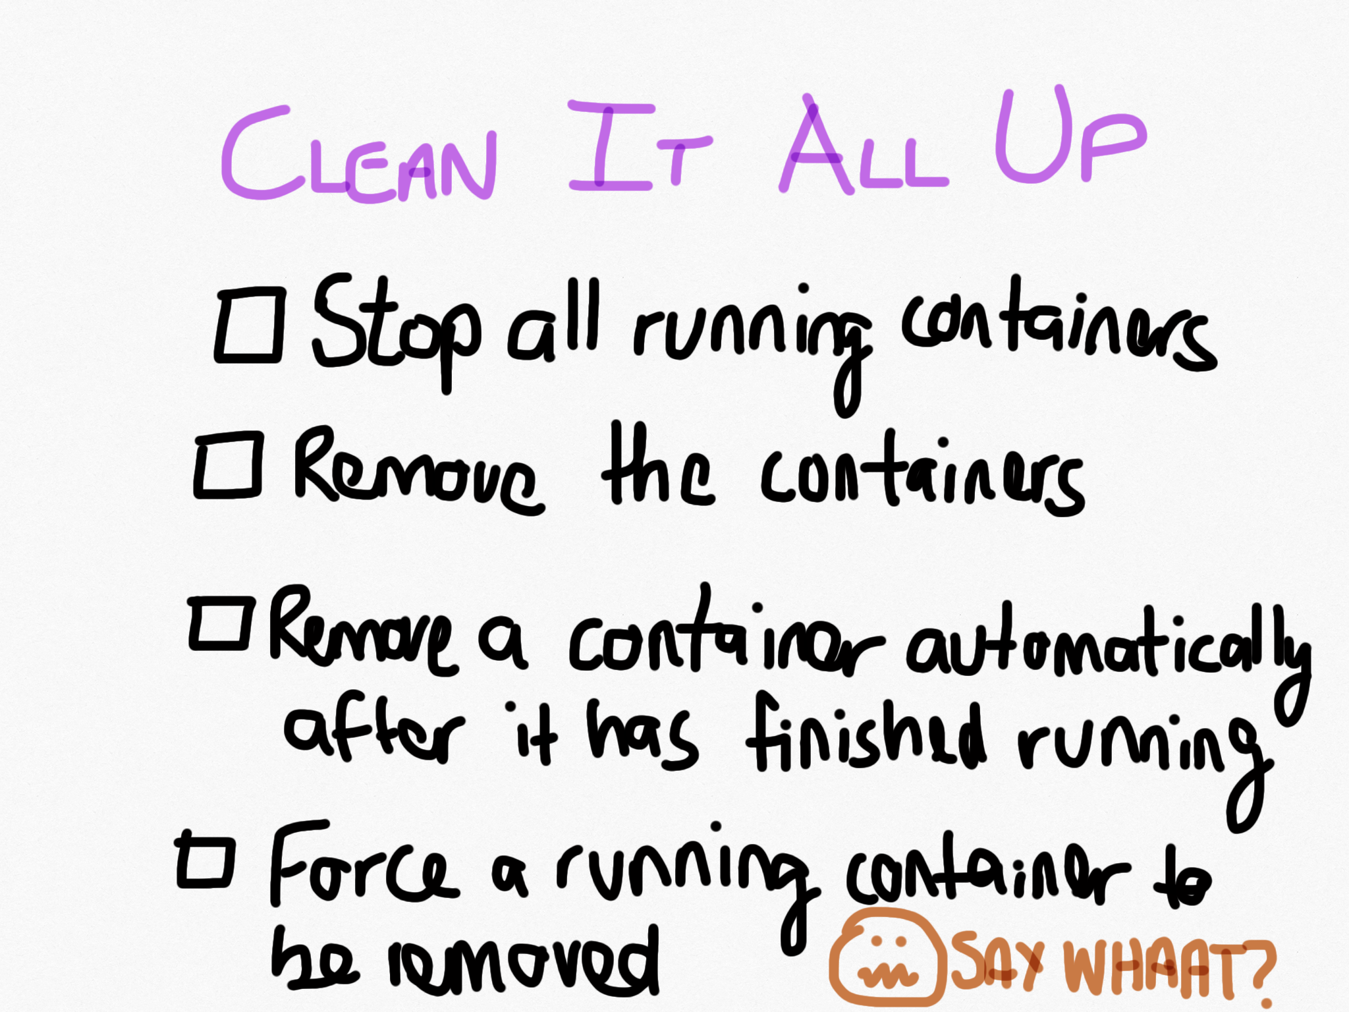

Slide 14
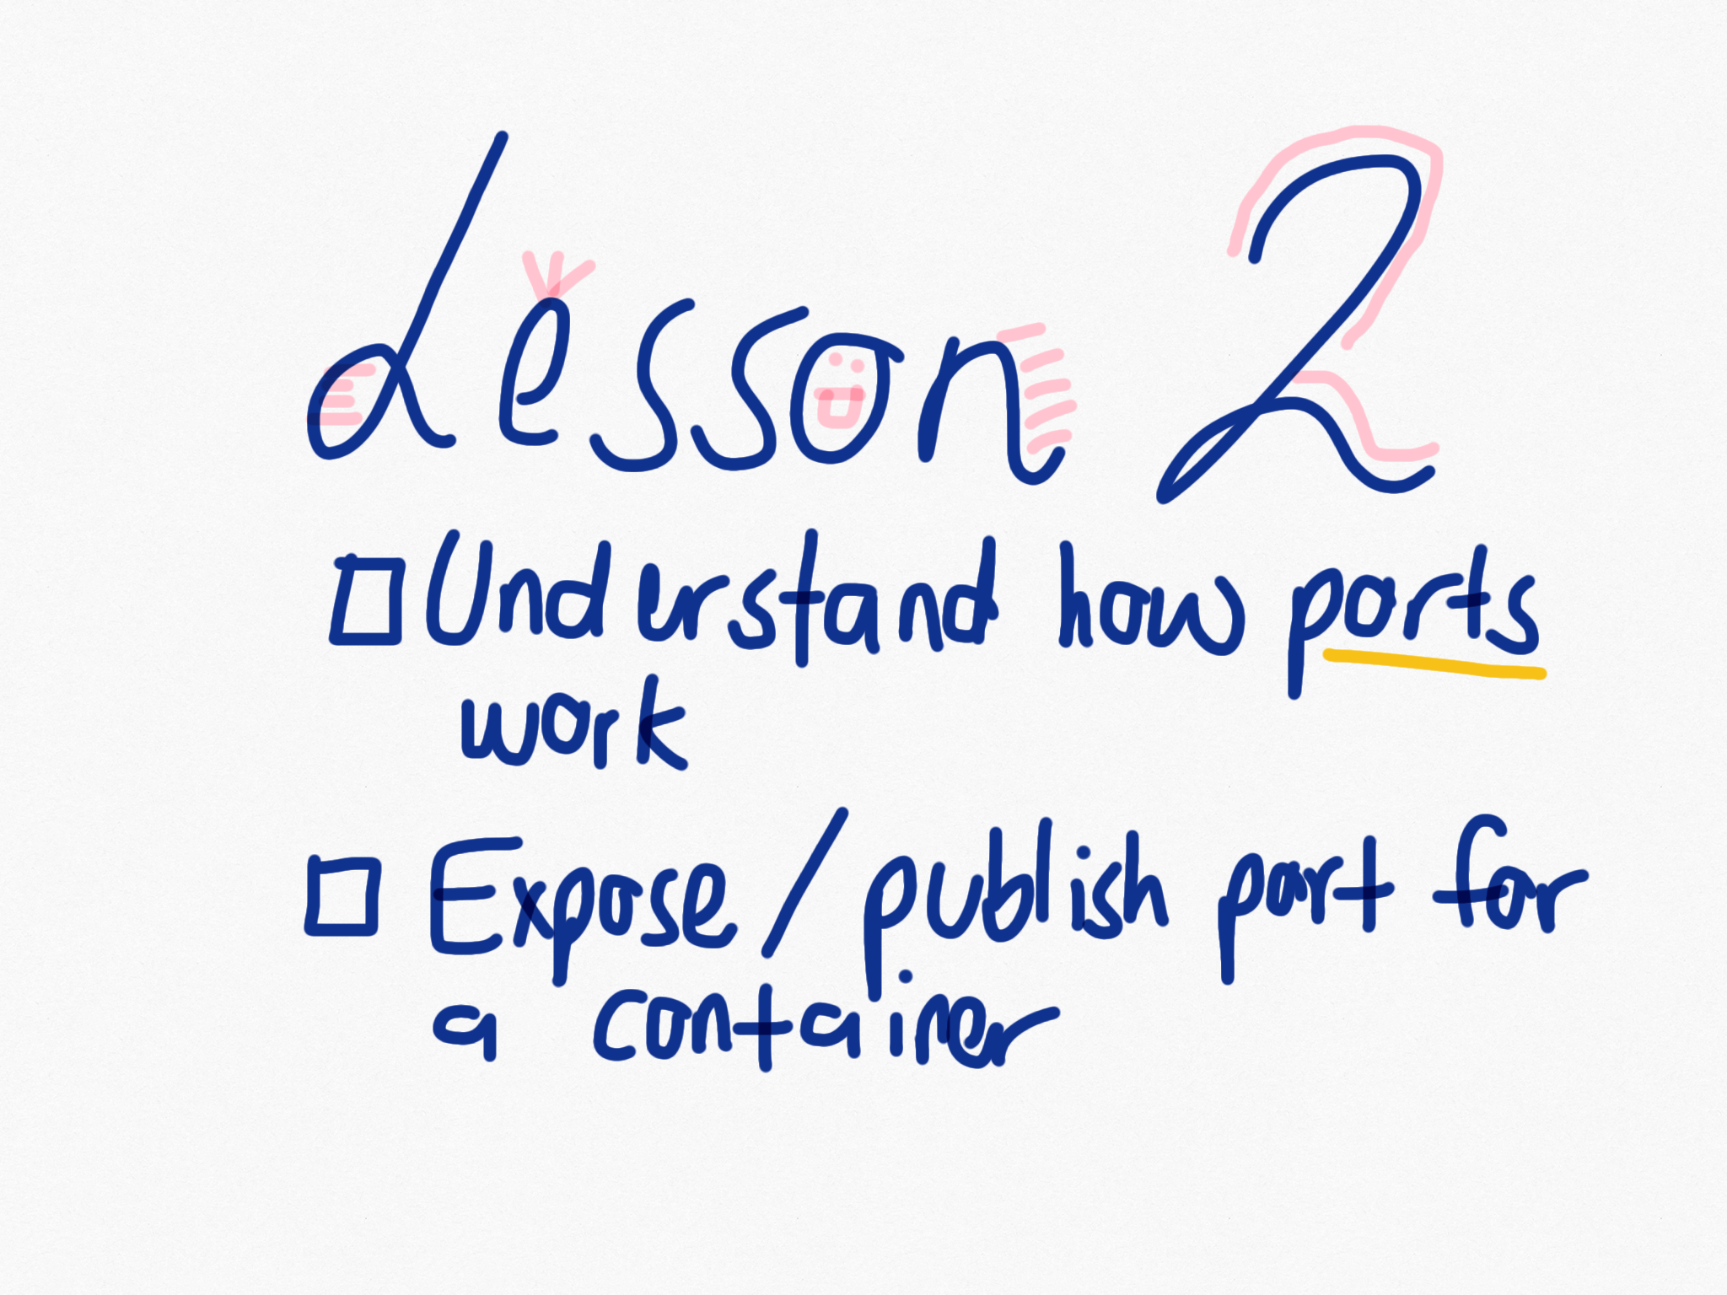

Slide 15
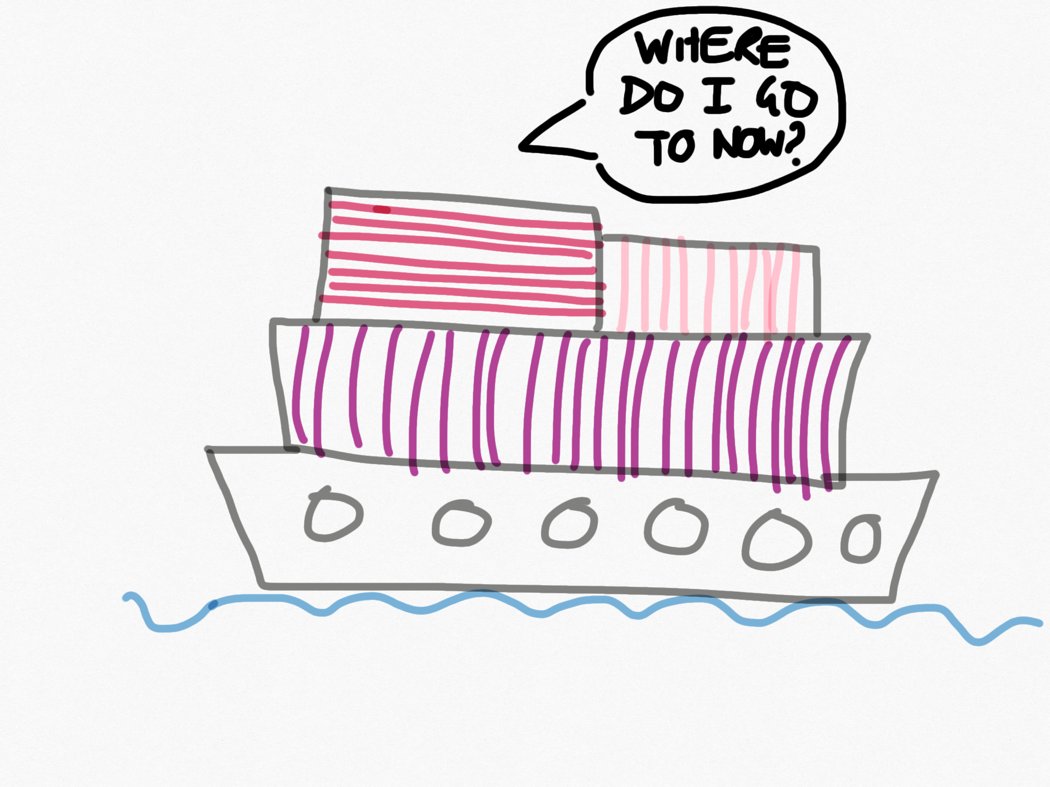

Slide 16
Like a shipping port?
A ship is assigned a specific port to deliver goods.
In a network, a port is a defined as a place where things can communicate with each other.
E.g. port 80 for HTTP/TCP connections
In Docker, a container needs a port to talk to other things too.
E.g. Talk to other Docker containers

Slide 18
Resources
Docker run
Exposing port

Slide 19
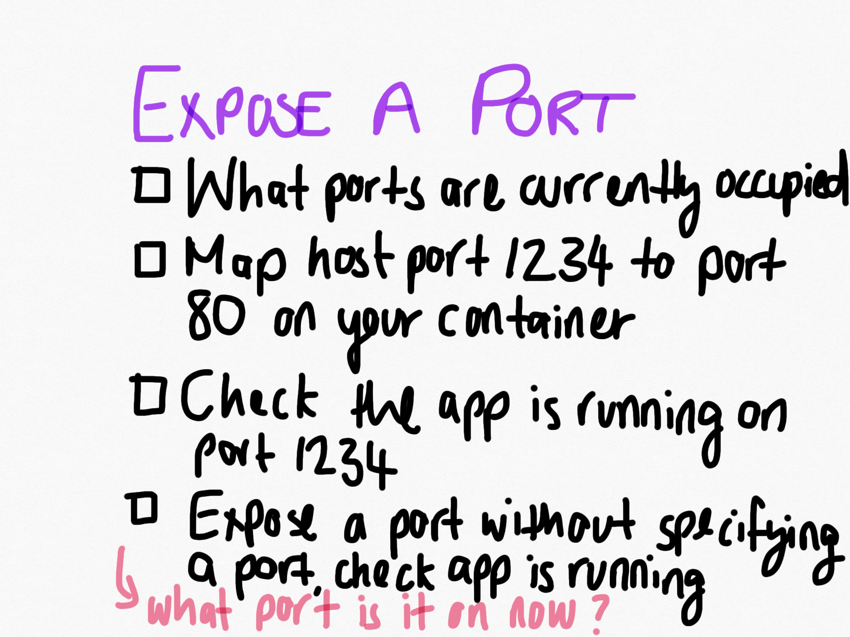

Slide 20
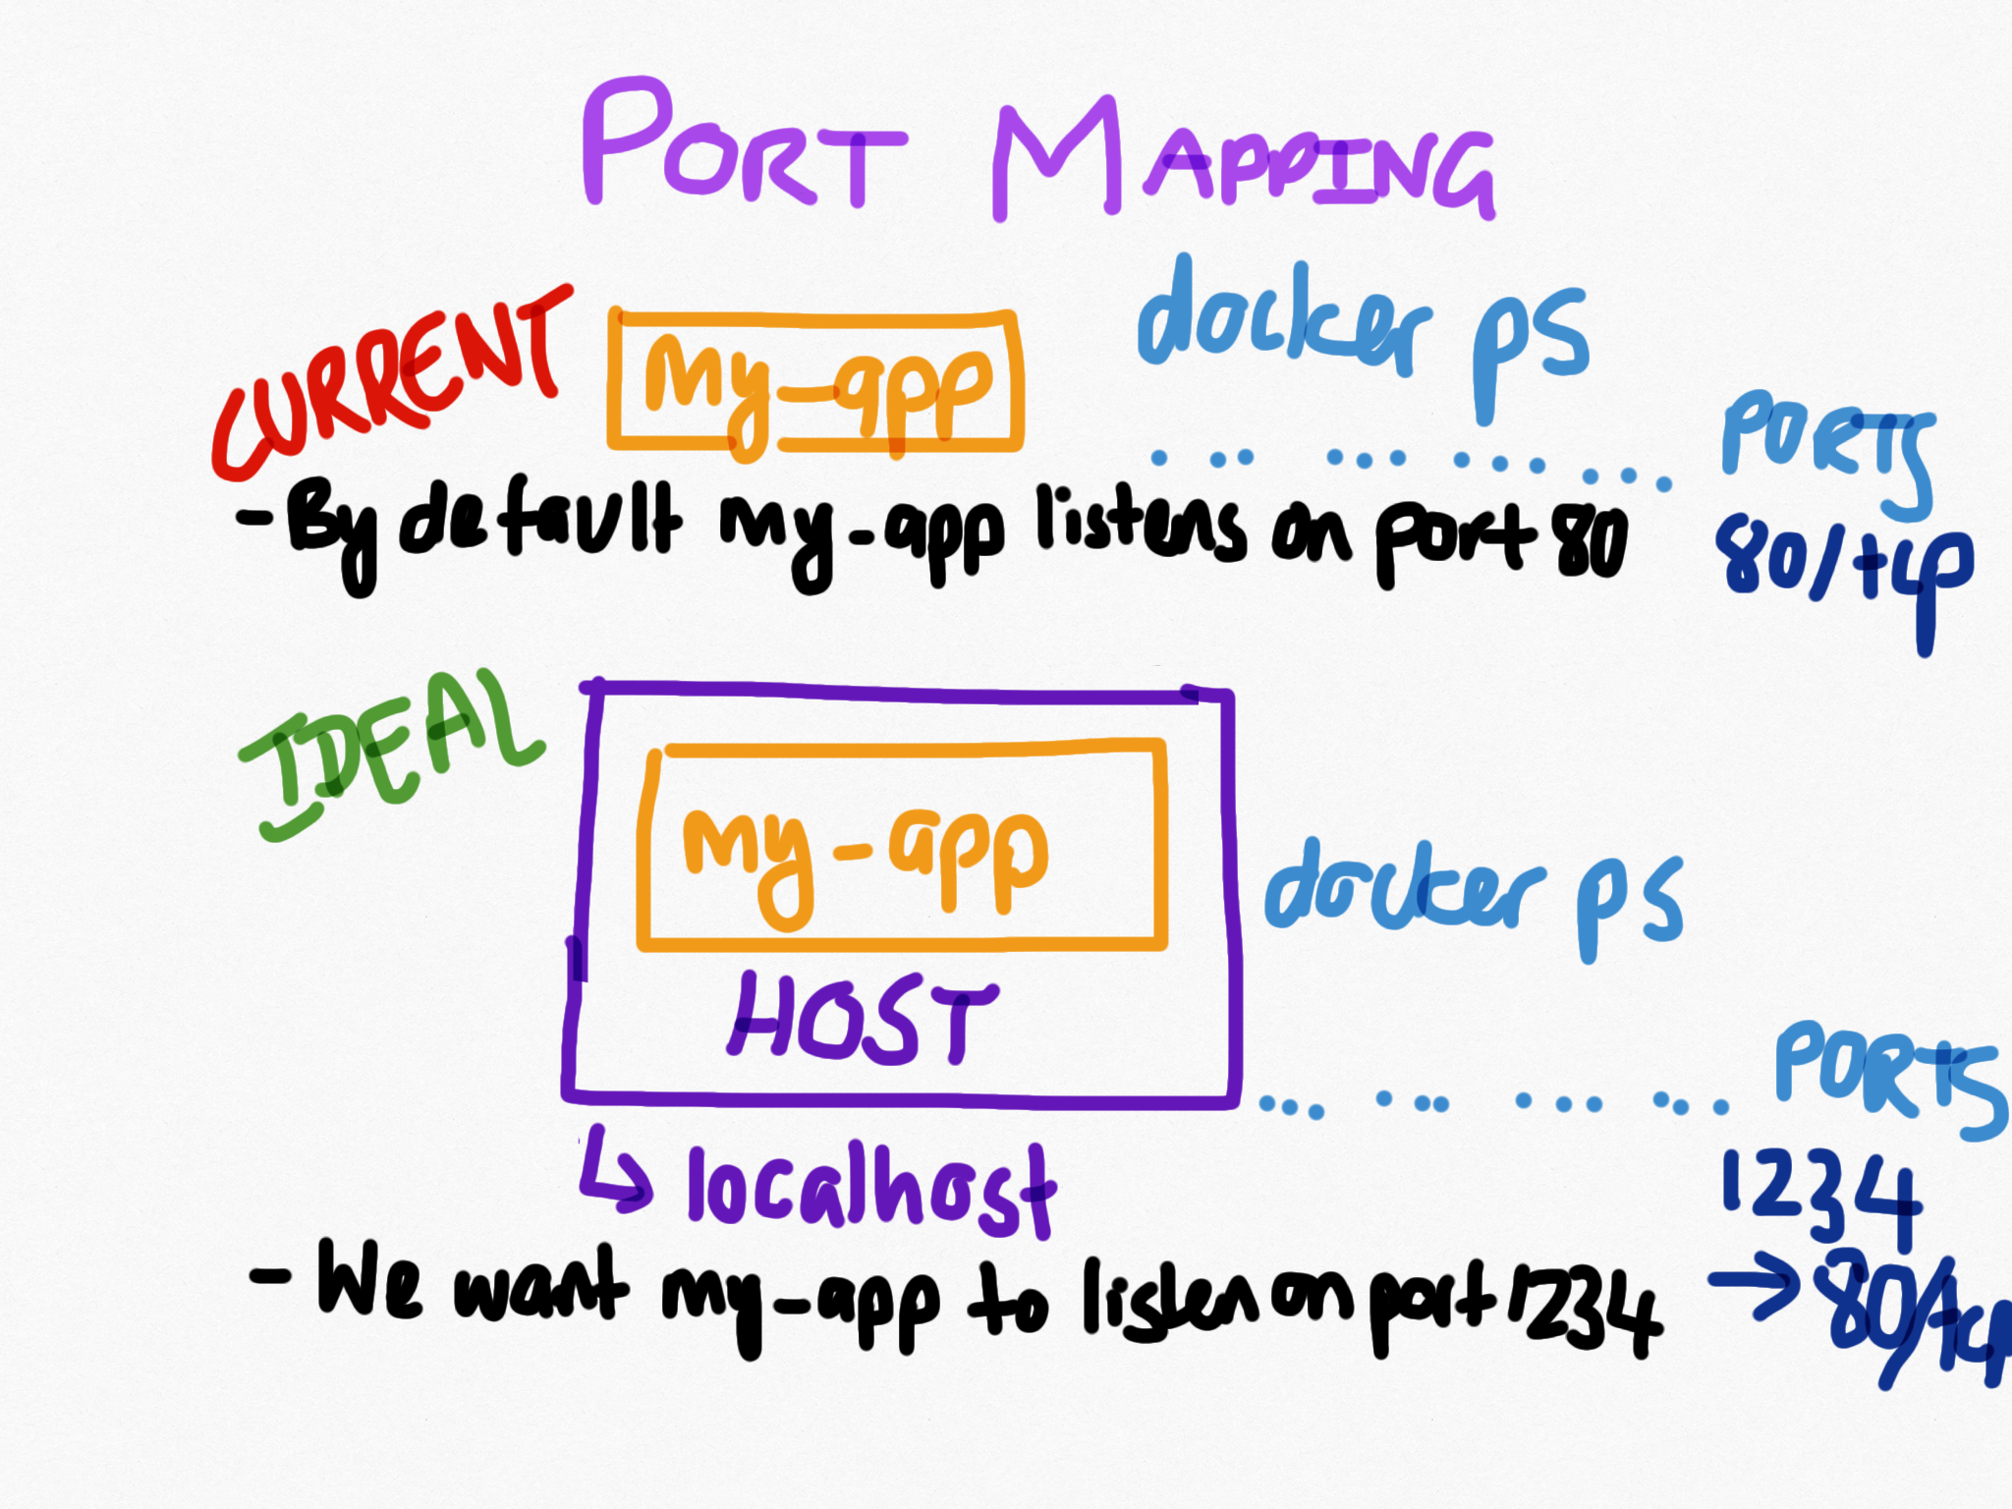

Slide 21
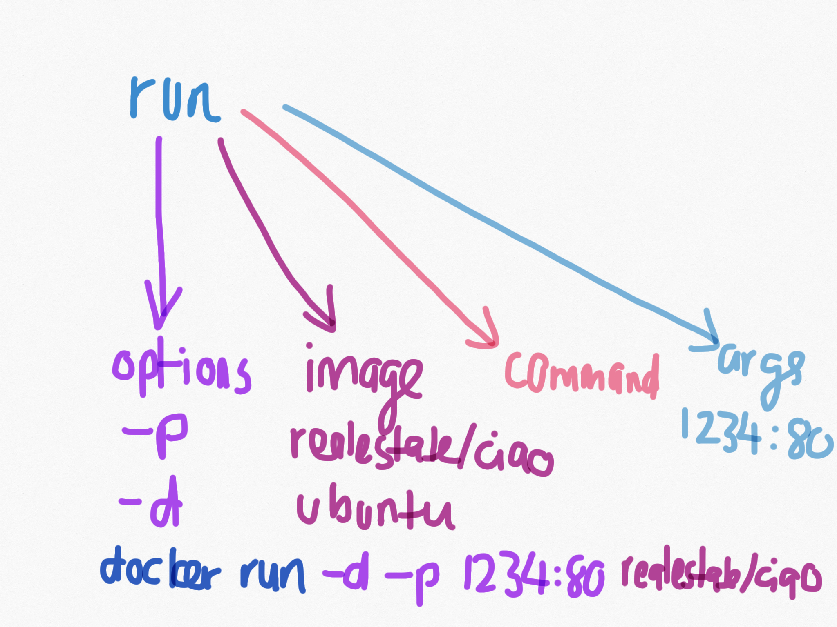

Slide 22
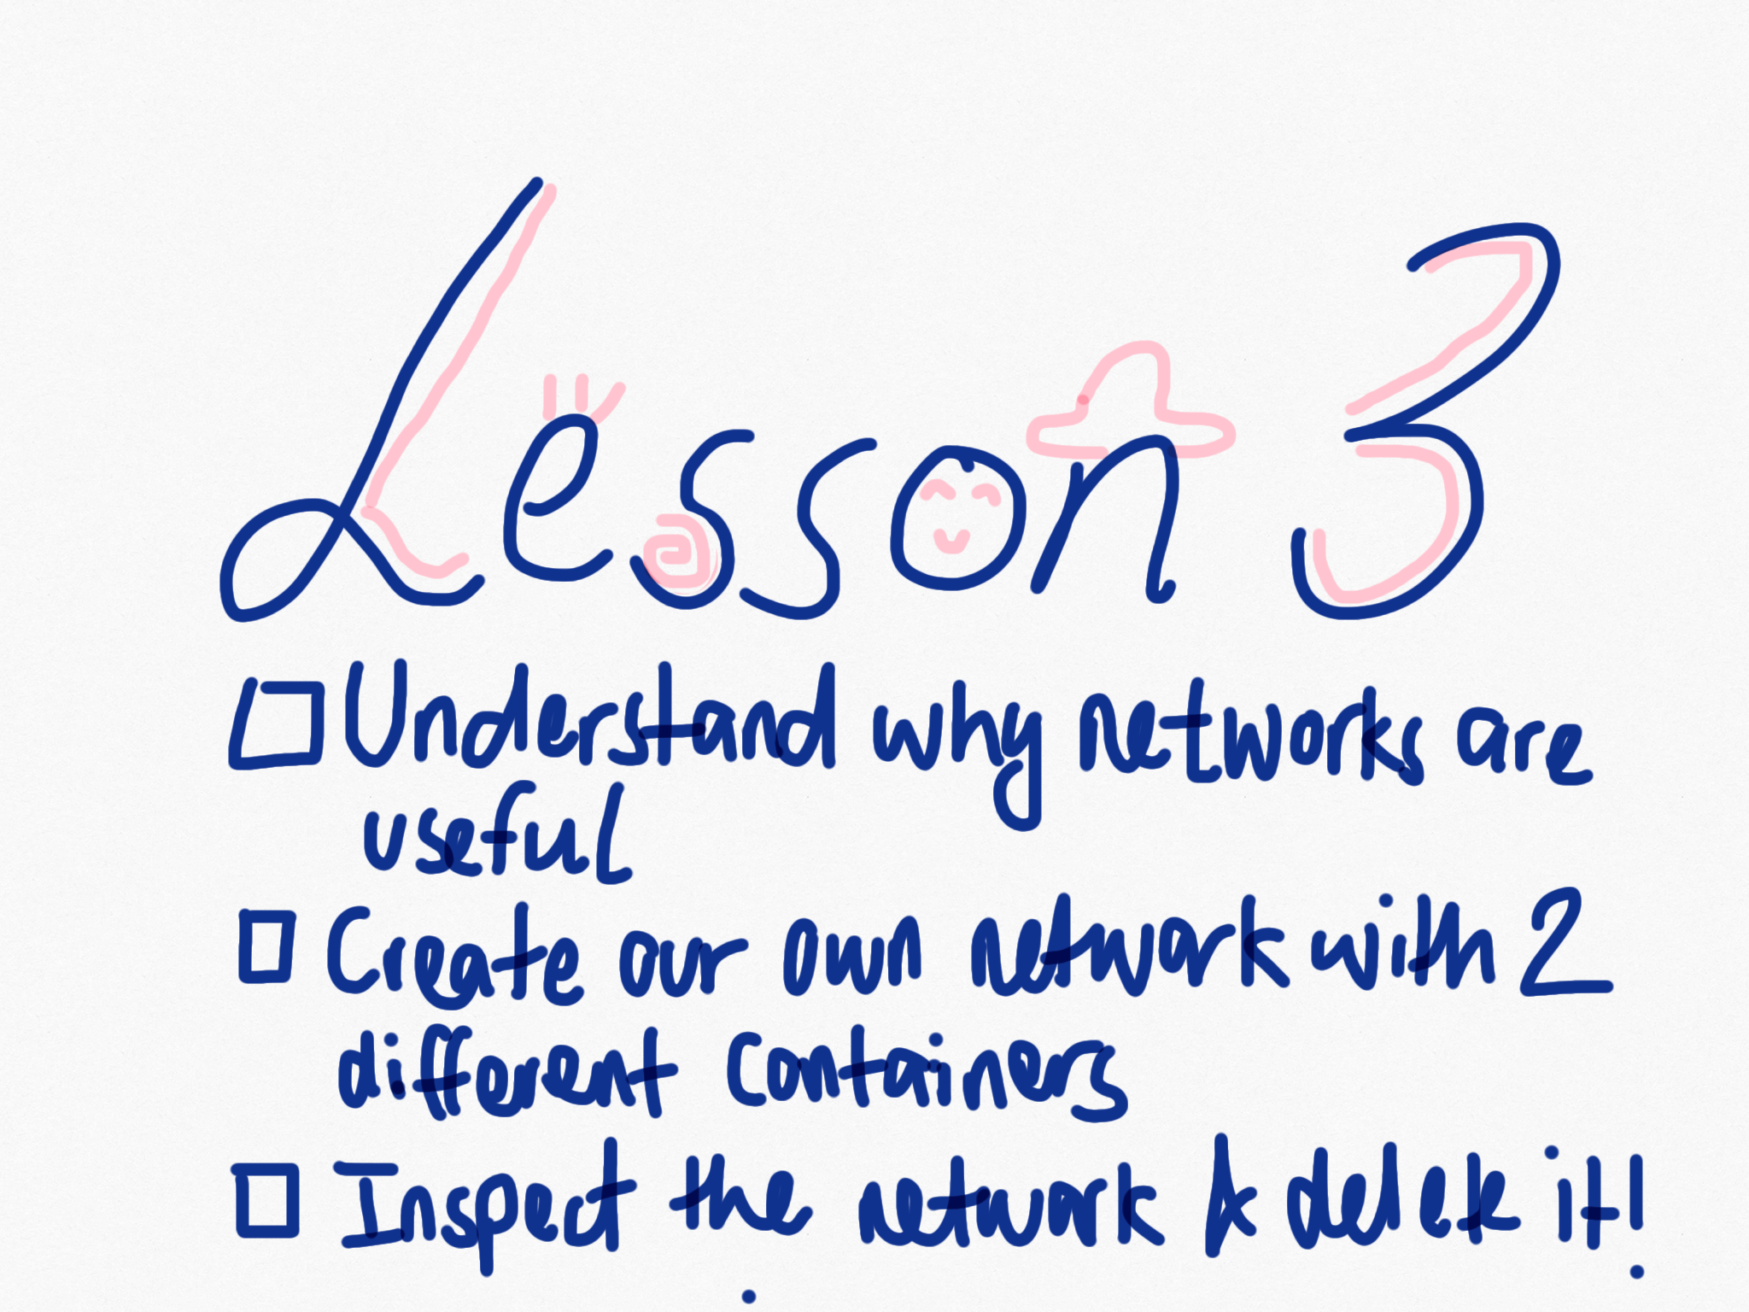

Slide 23
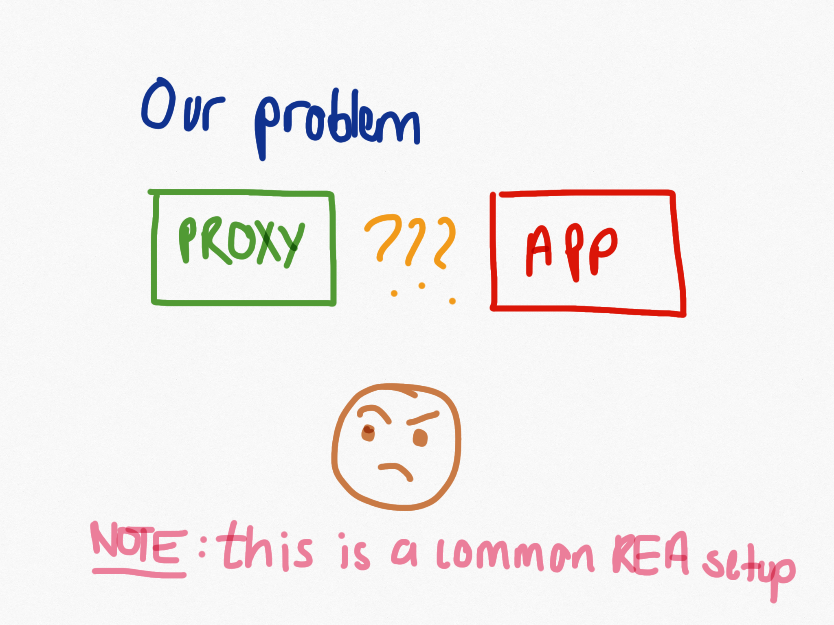
Notes:
Each container is isolated, they need to communicate over the network

Slide 24
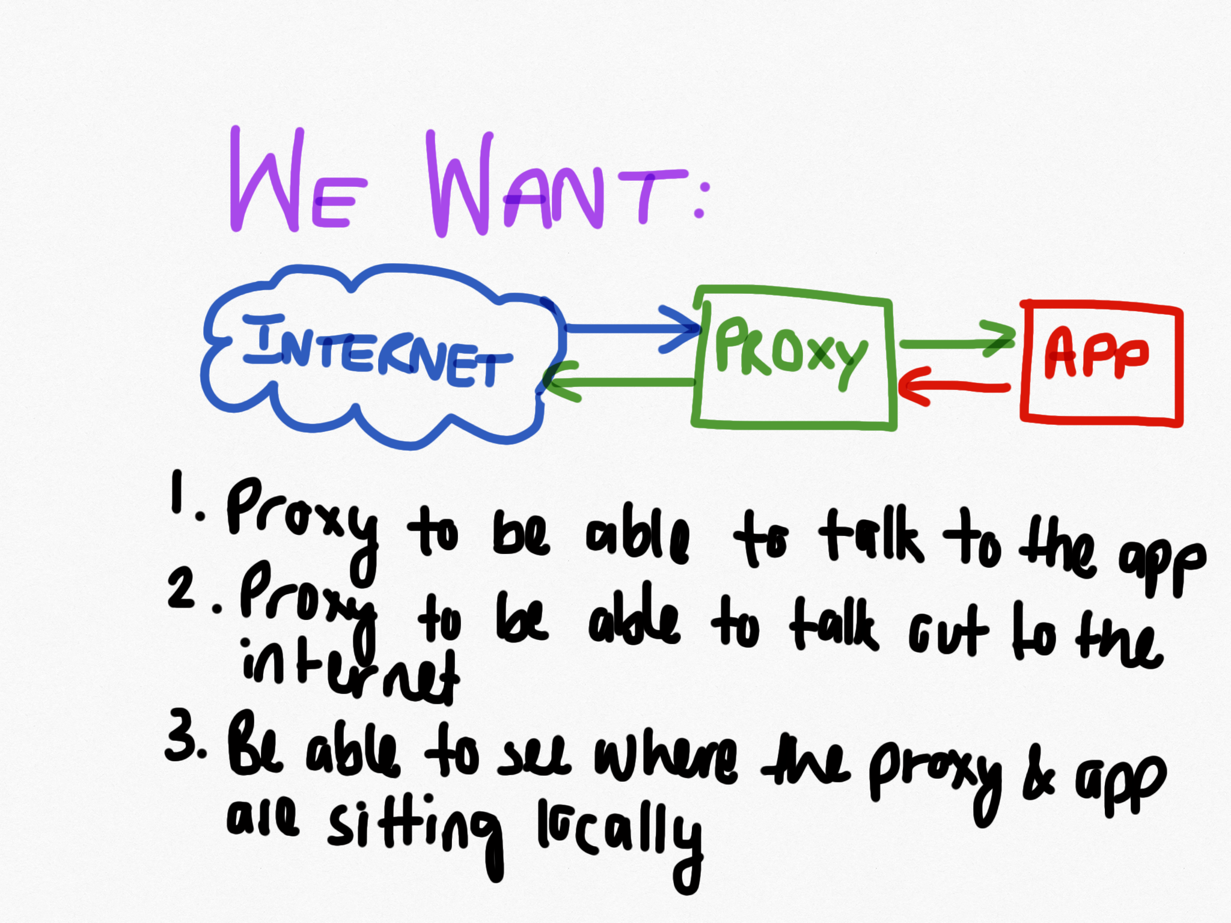

Slide 26
Resources
Network
Use realestate/ciao-proxy as image for the proxy
This is an NGINX server that is configured as a reverse proxy
It is currently listening on port 80
It is set up to forward requests specifically to ‘app’
NB: Make sure that you call your app container ‘app’

Slide 27
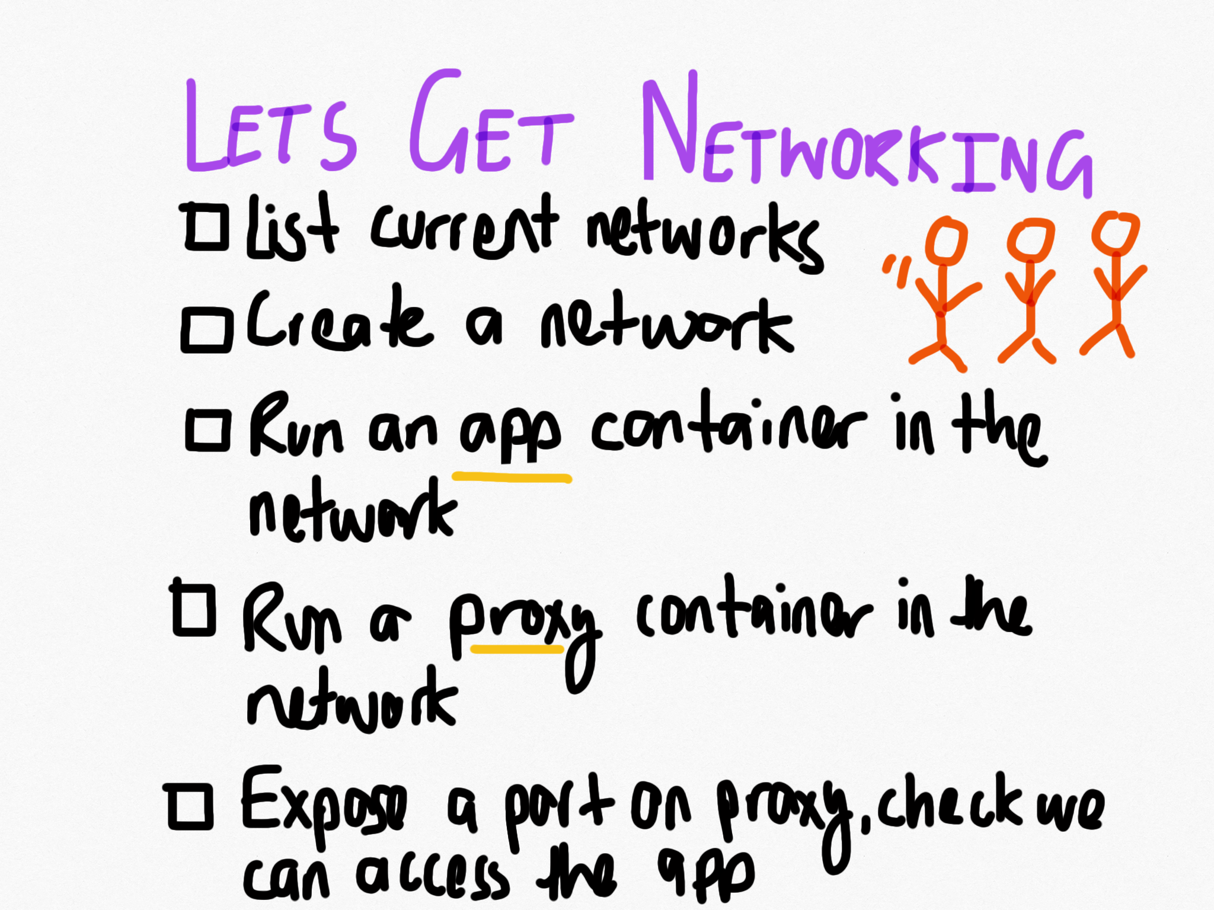

Slide 28
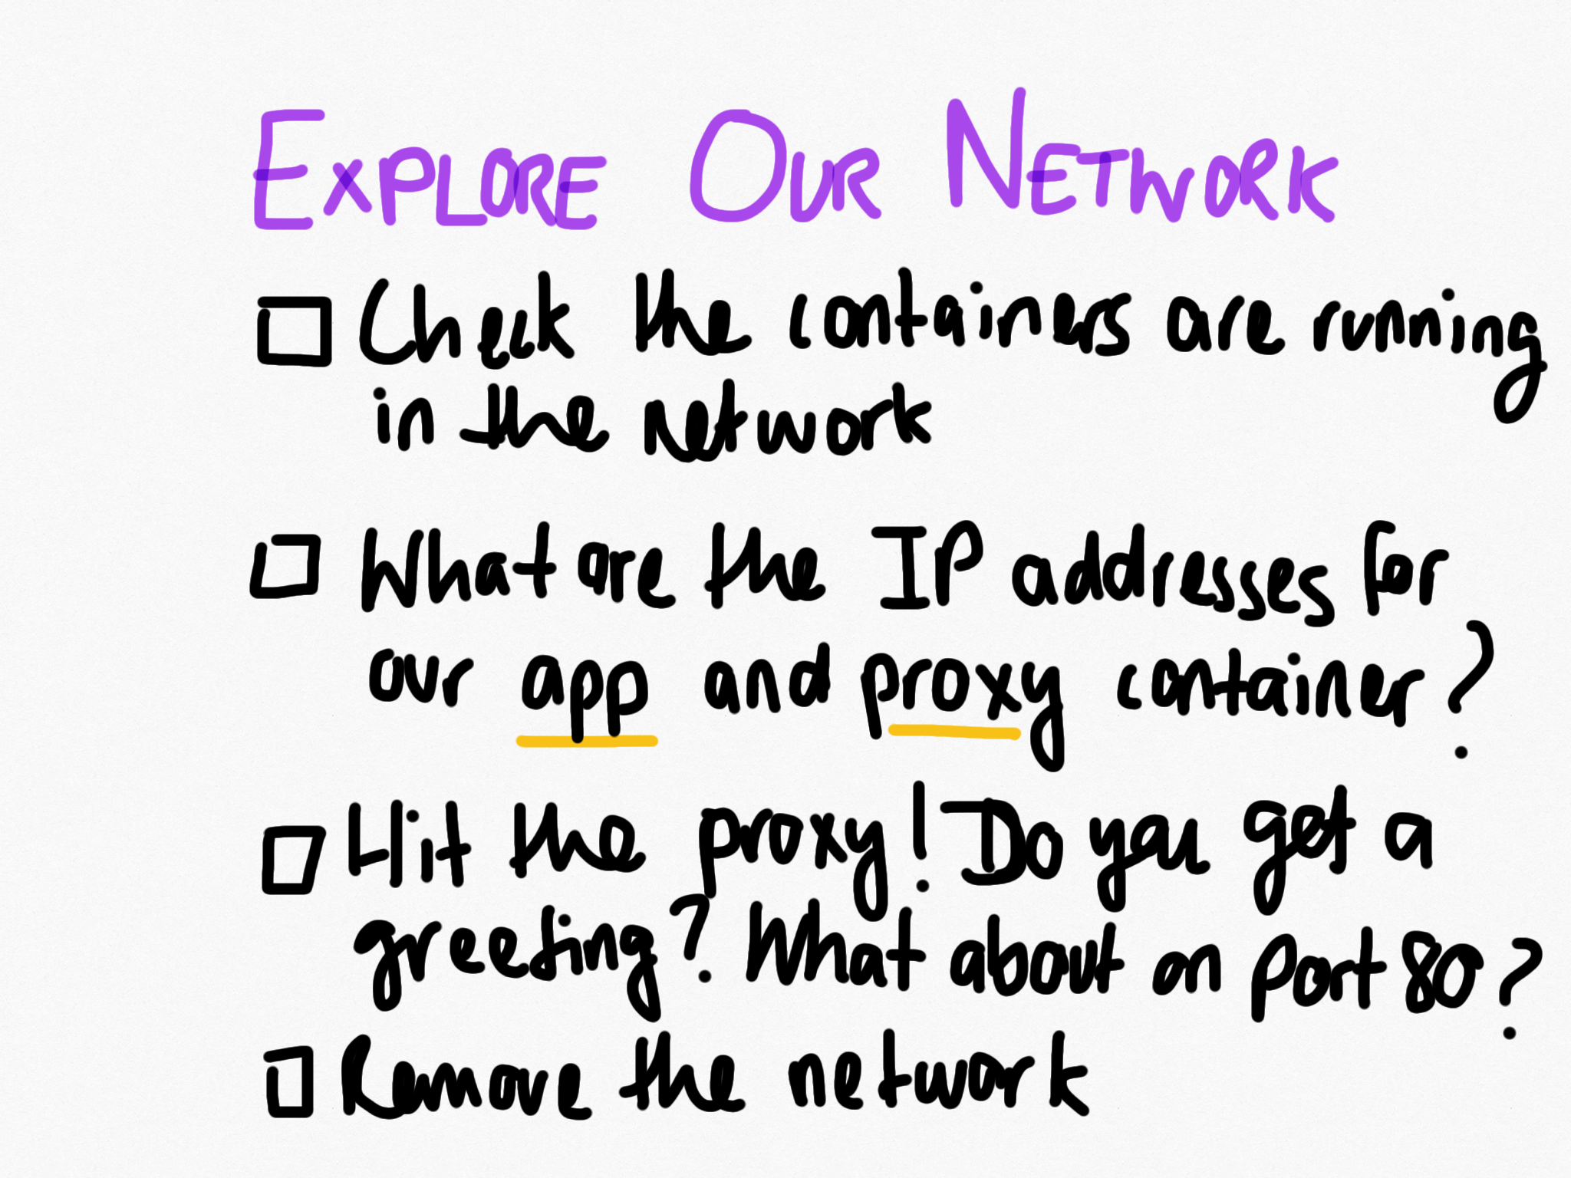

Slide 29
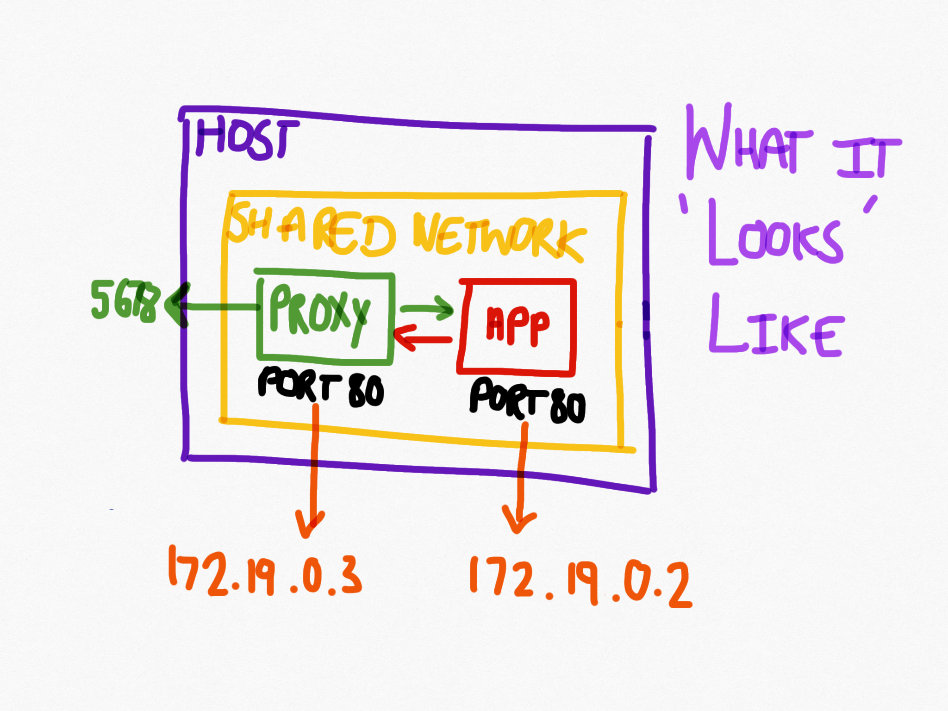

Slide 30
Whew, feeling a bit like this?

Slide 31
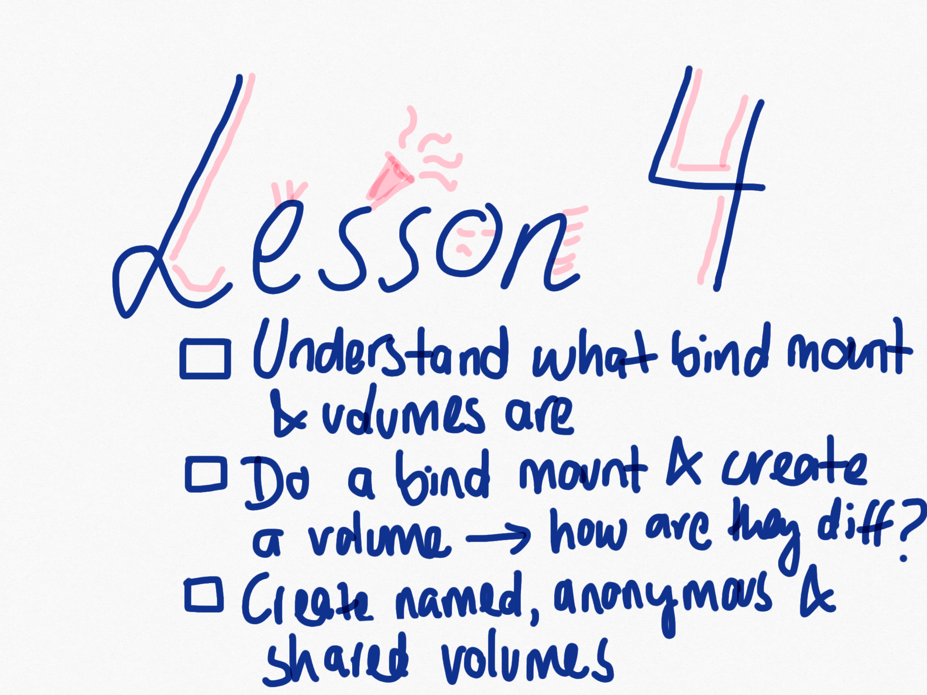

Slide 32
Resources
Docker volume
Docker bind mount
Understanding volumes

Slide 34
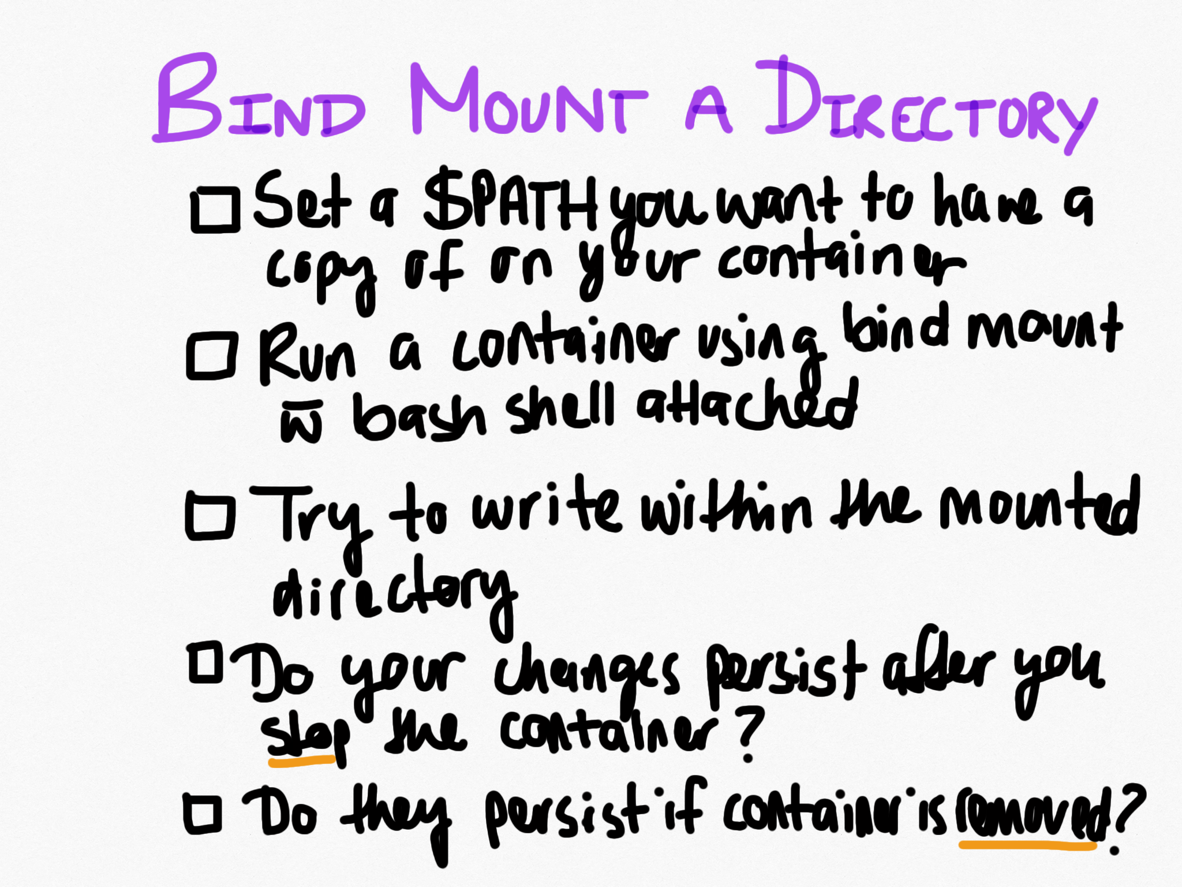

Slide 35
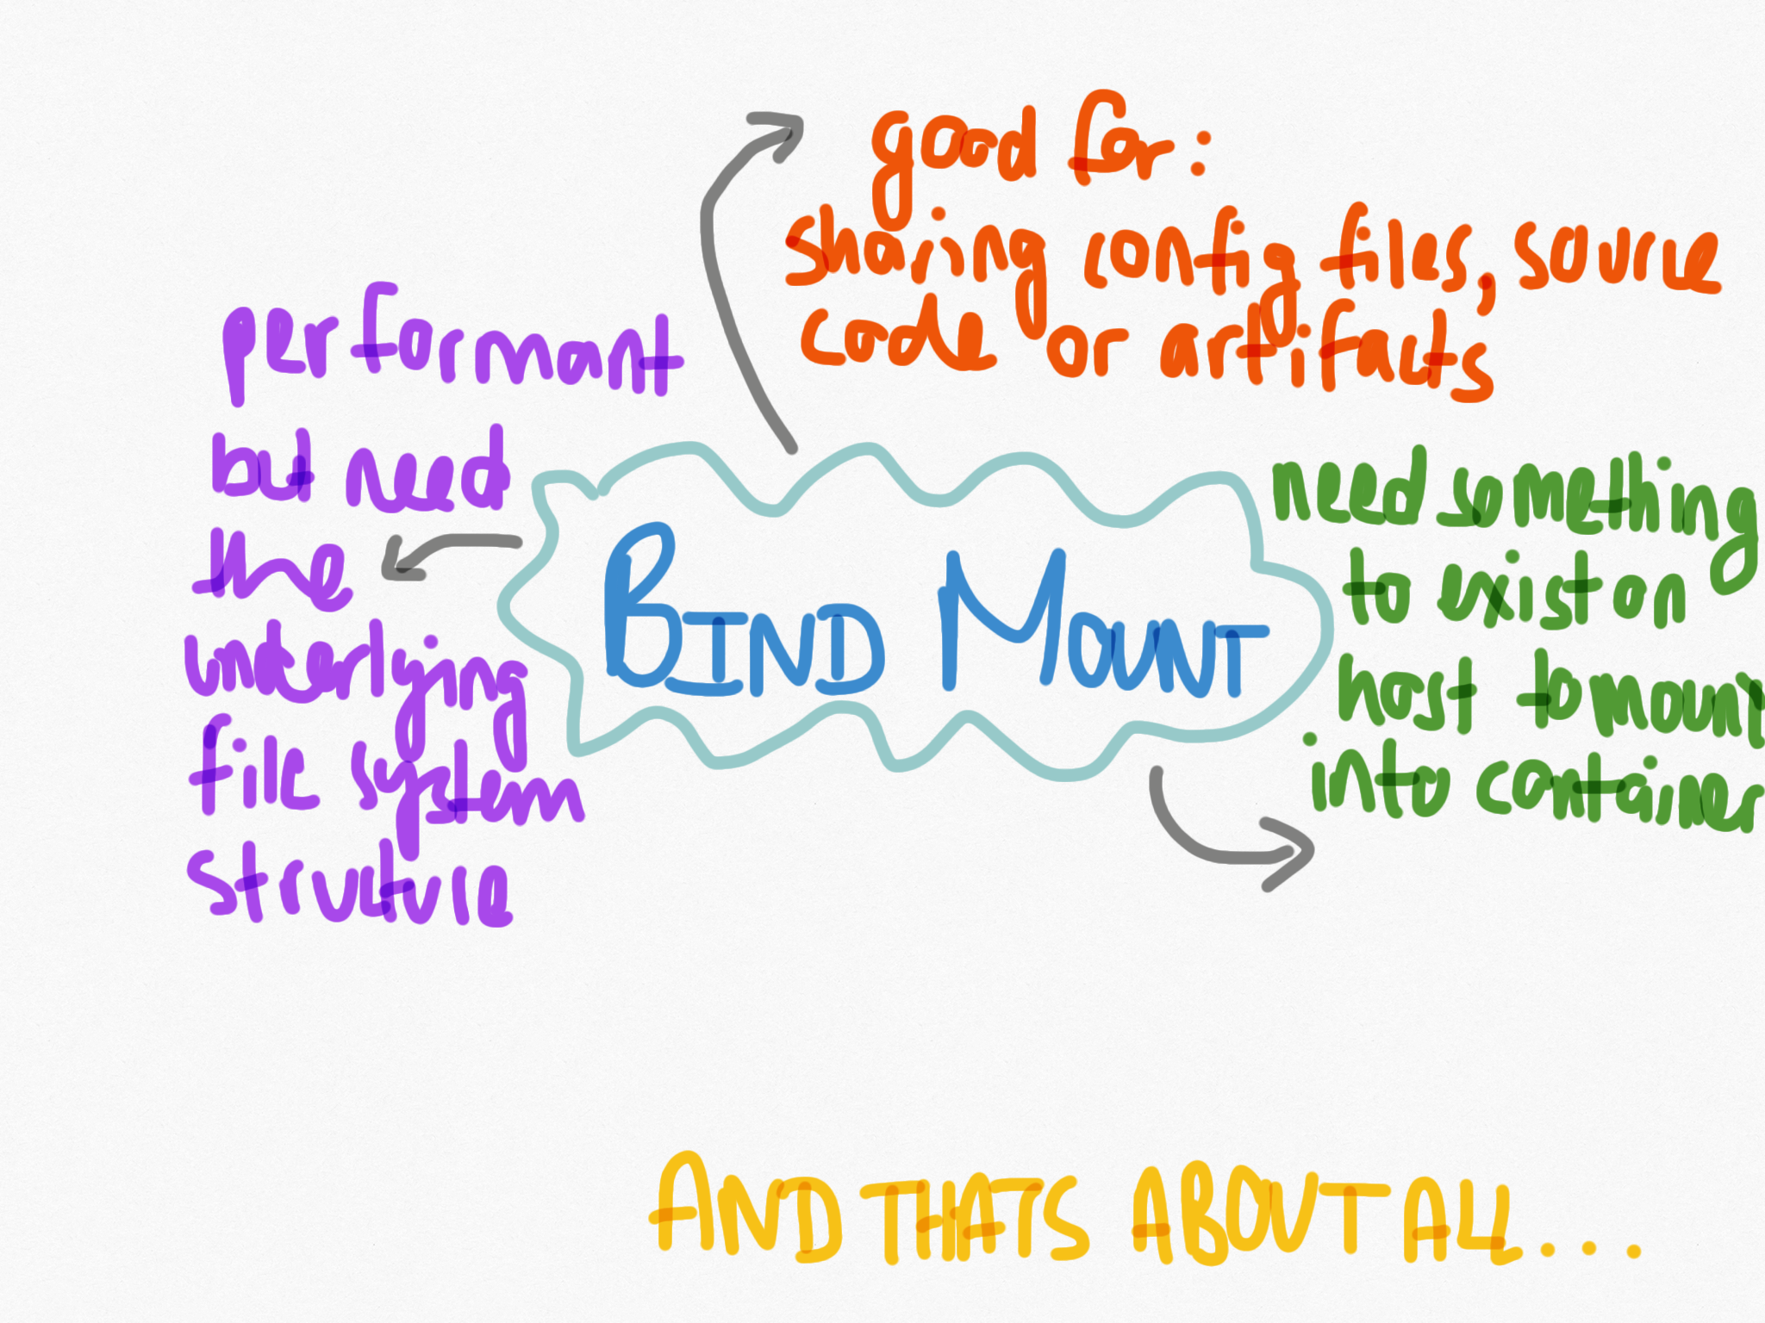

Slide 36
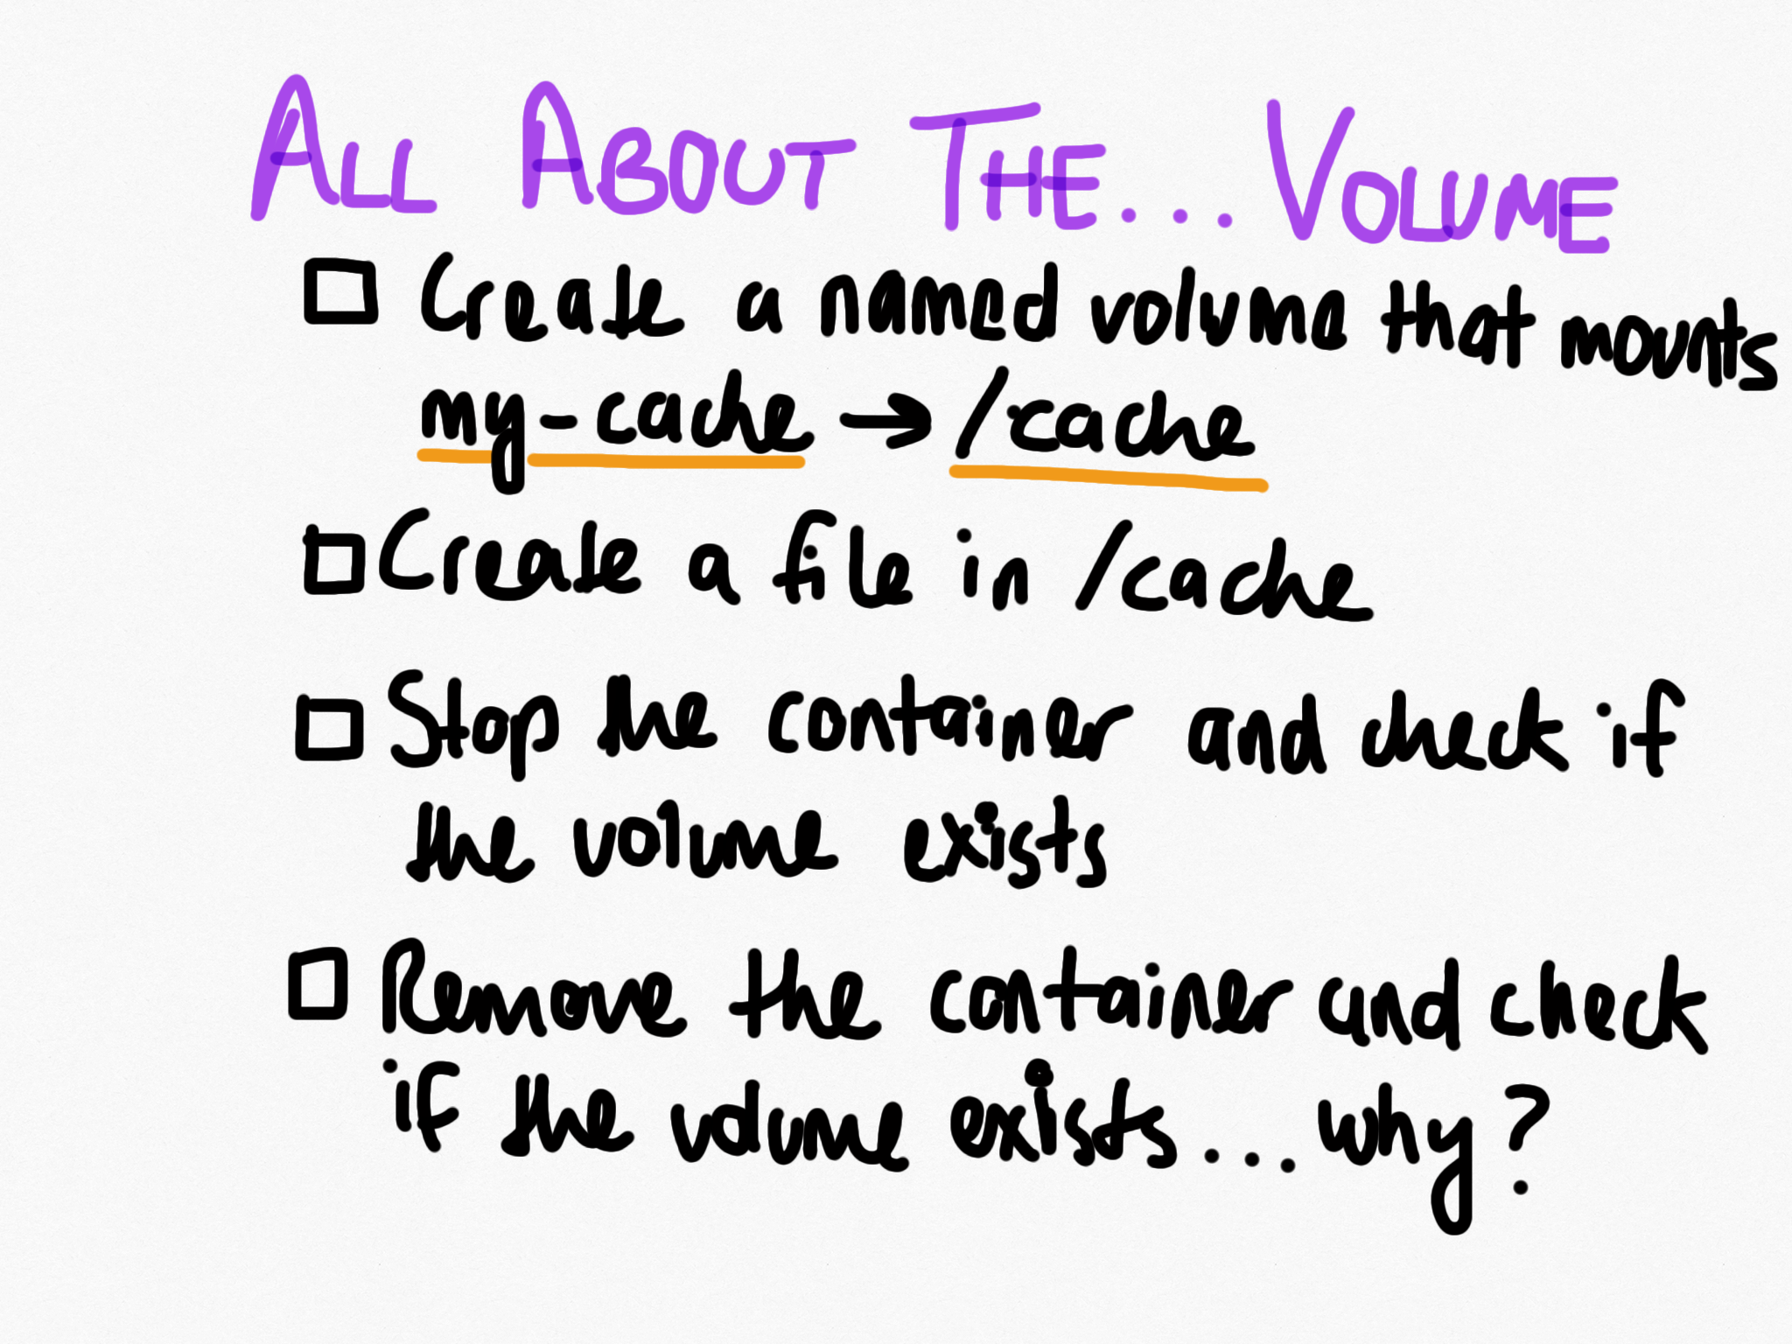

Slide 37
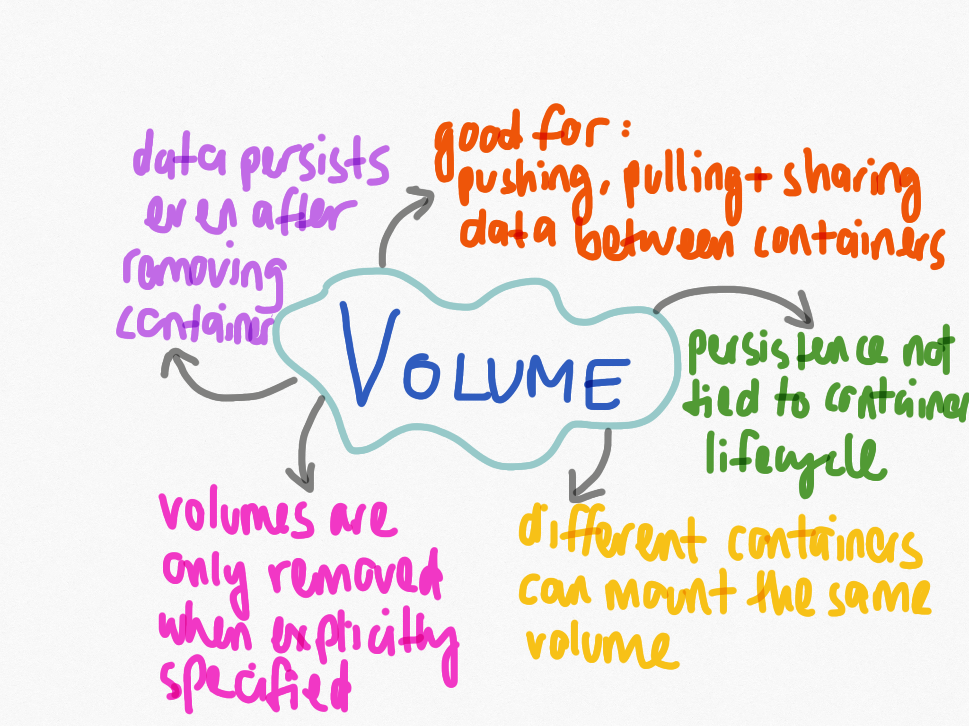

Slide 38
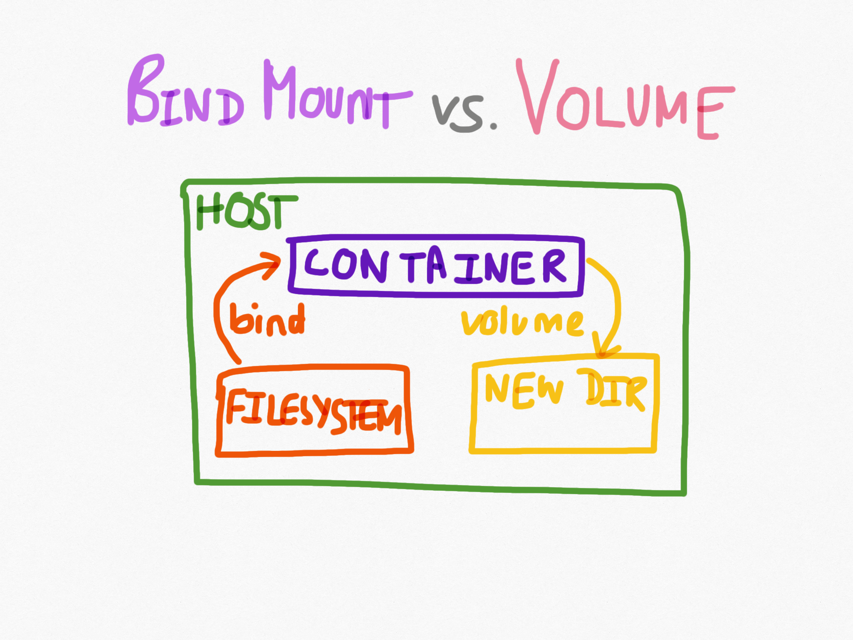

Slide 39
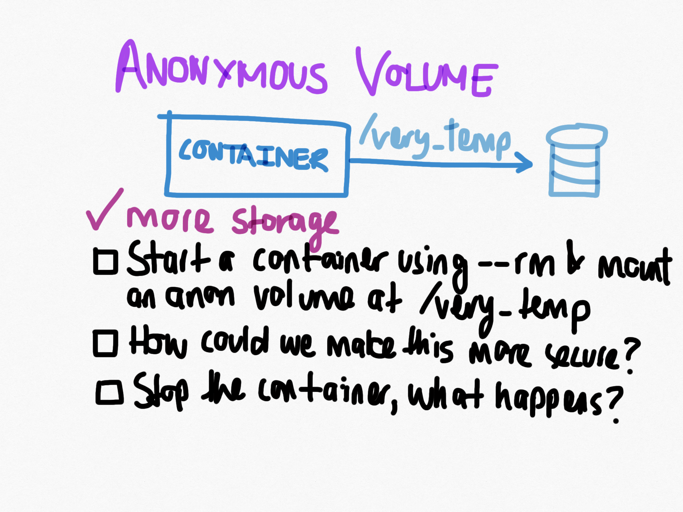

Slide 40
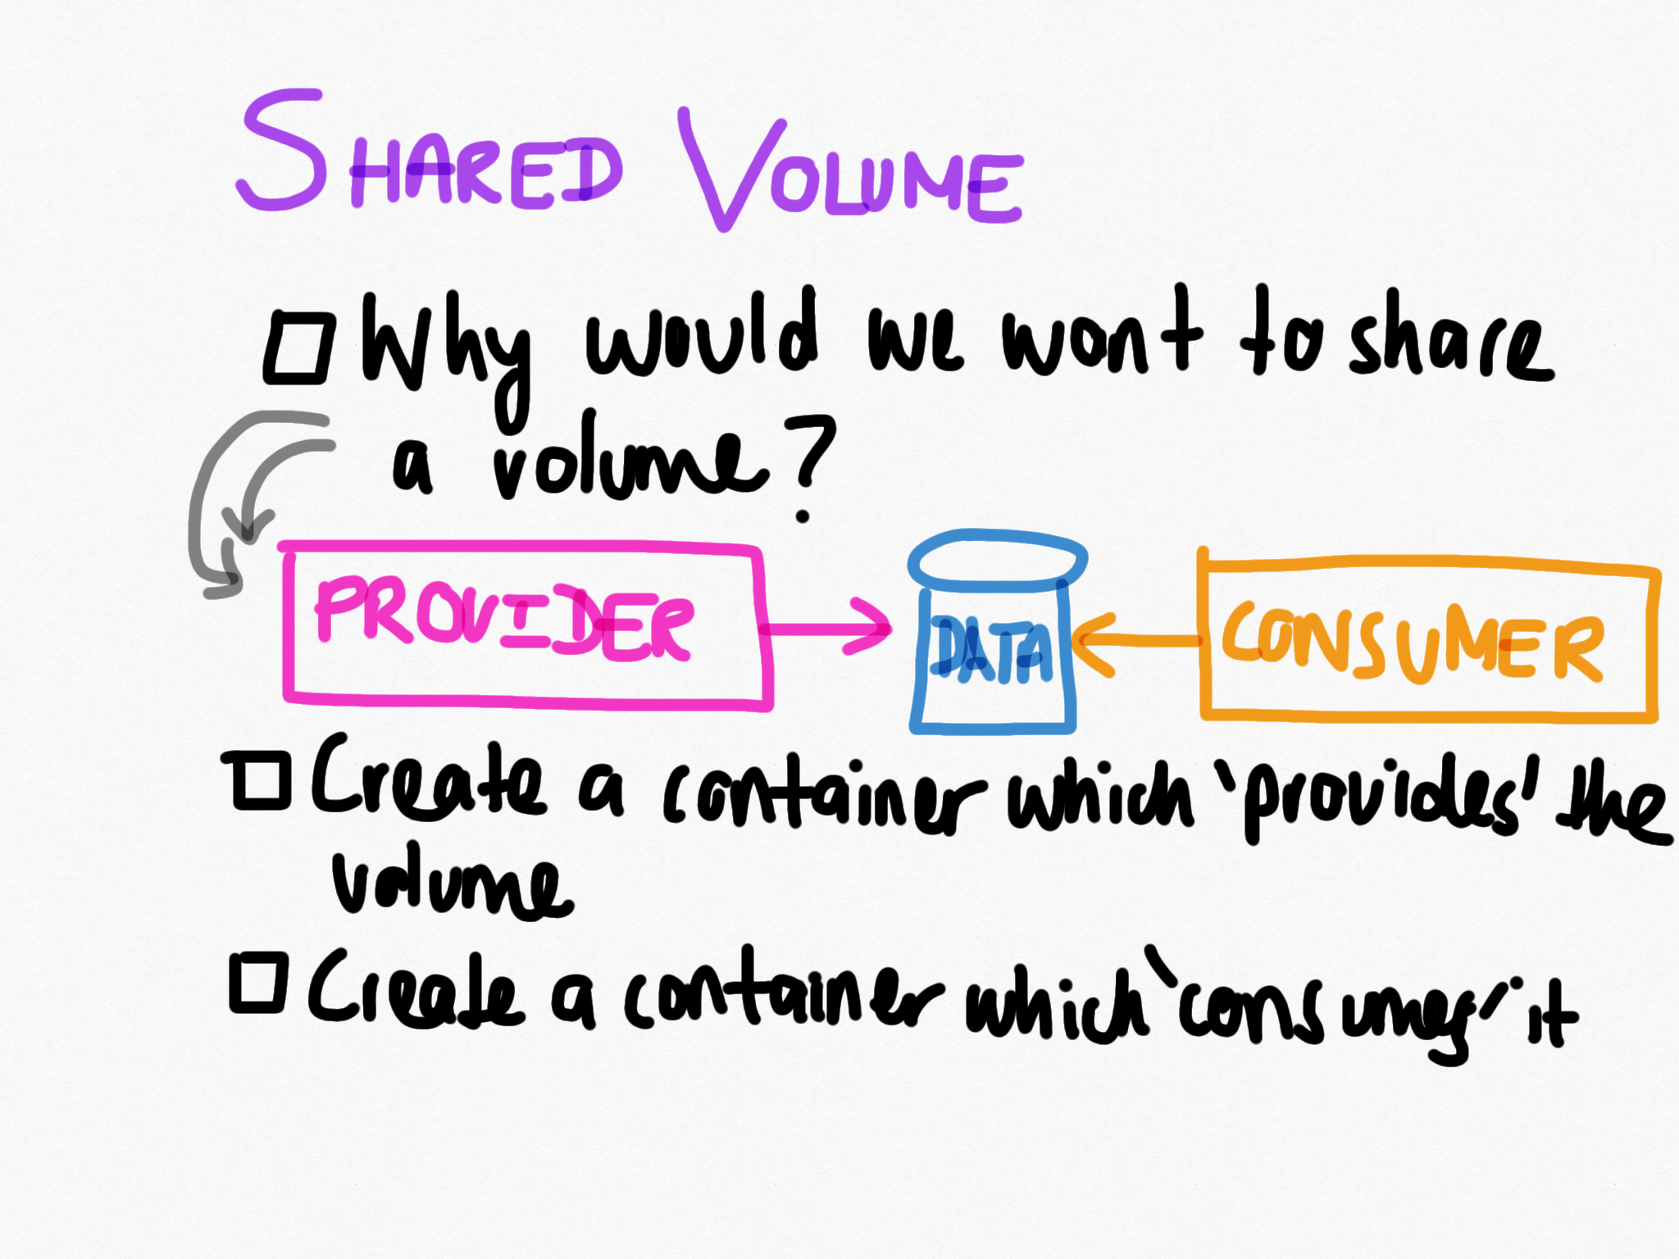

Slide 41
Are we done yet? …so close

Slide 42
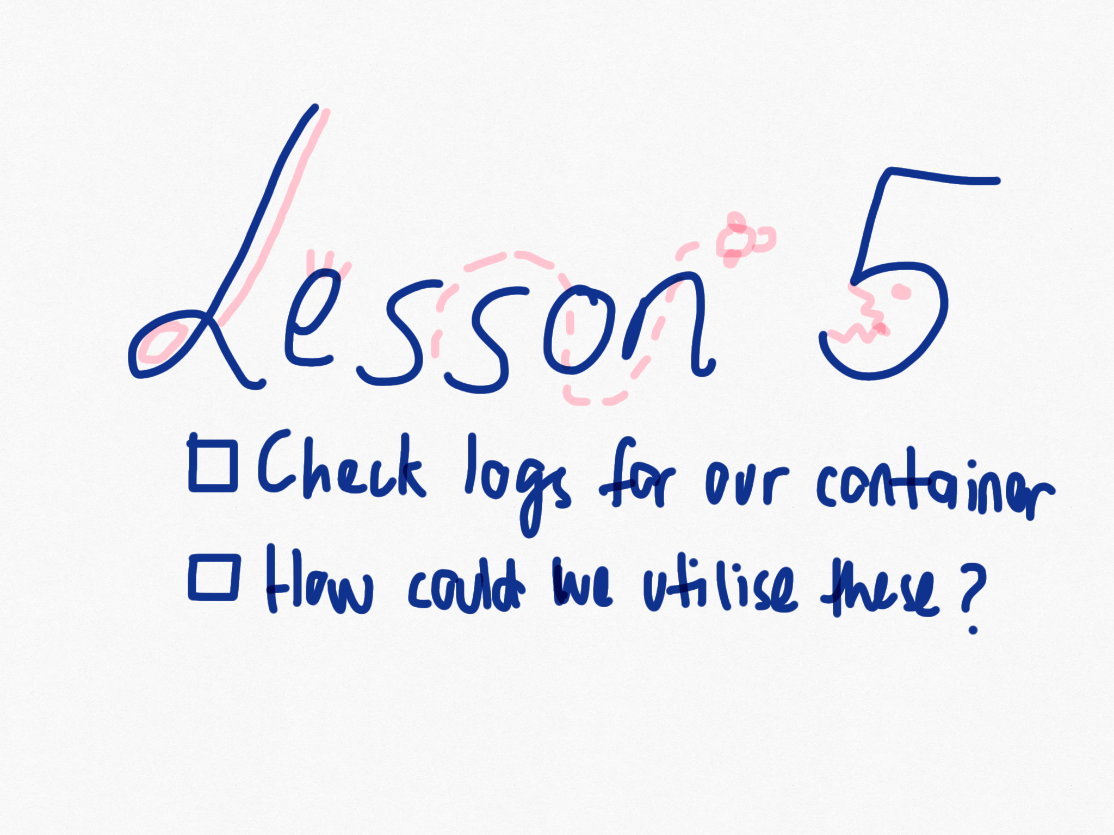

Slide 44
Resources
Docker Logs

Slide 45
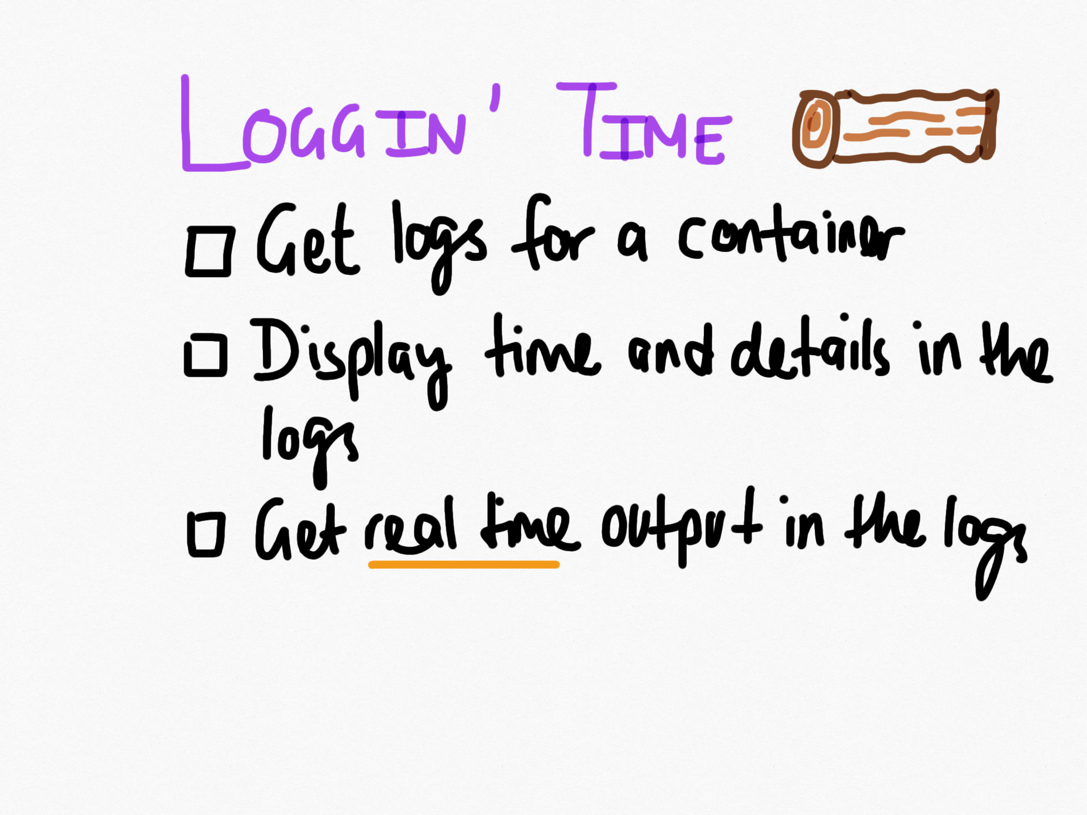

Slide 46
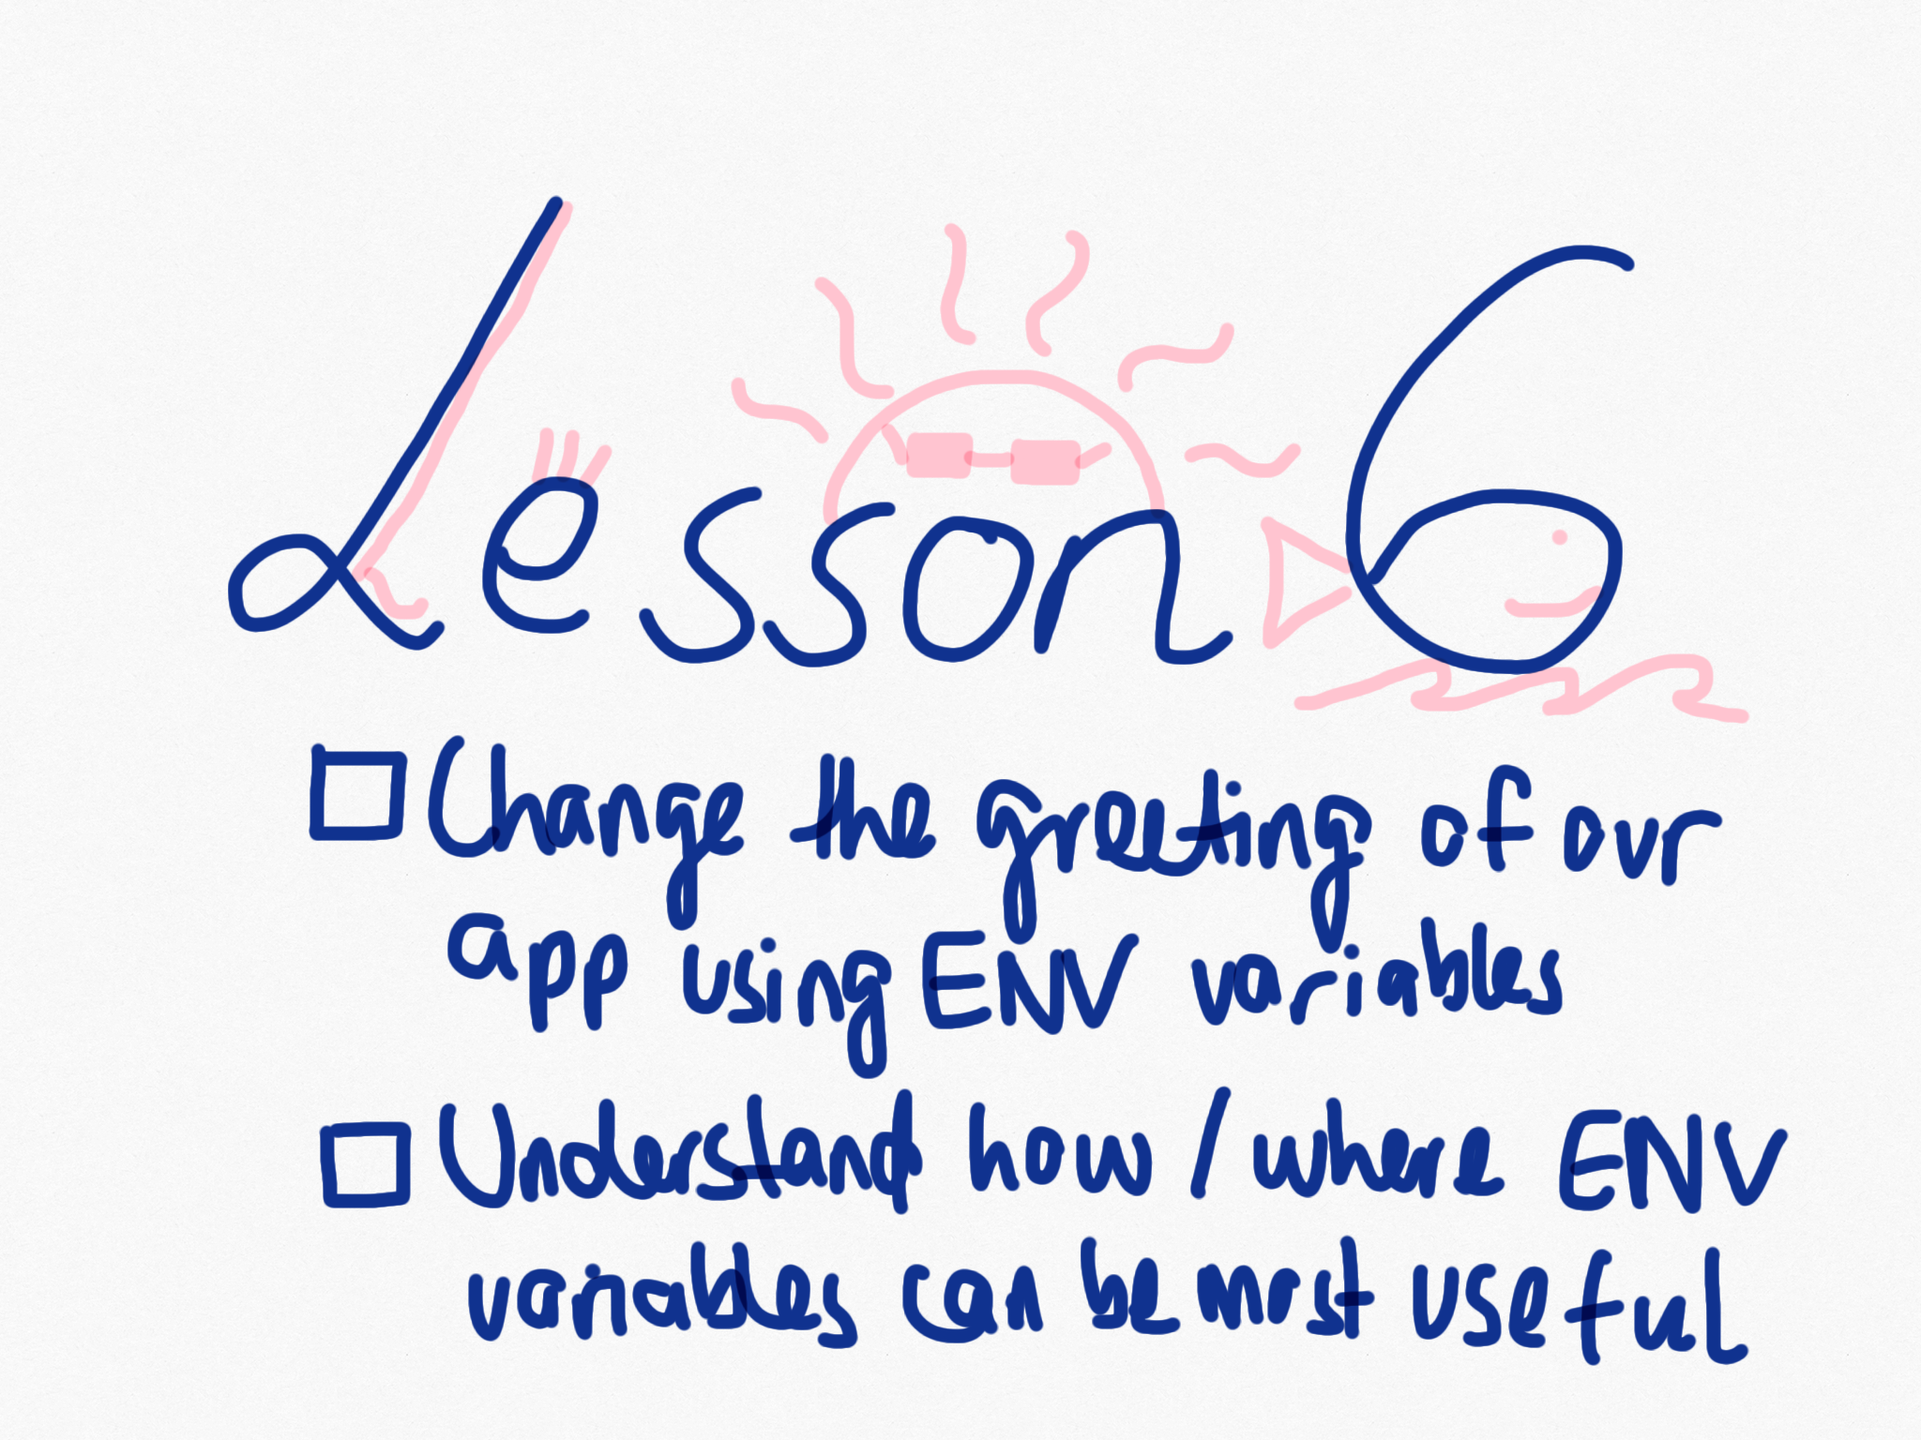

Slide 48
Resources
Docker run search for –env
Code for where environment variable is: https://github.com/realestate-com-au/intro-to-docker/blob/gh-pages/exercises/ciao/index.js#L5

Slide 49
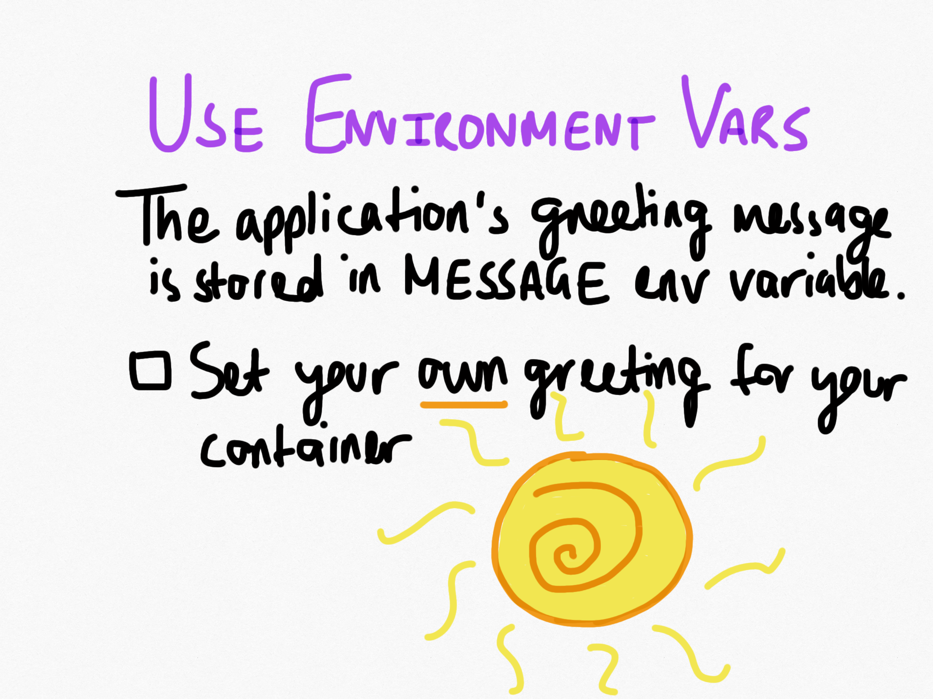

Slide 50


Slide 51
Woo, finito!
And here are the solutions for reference

